Slide 1
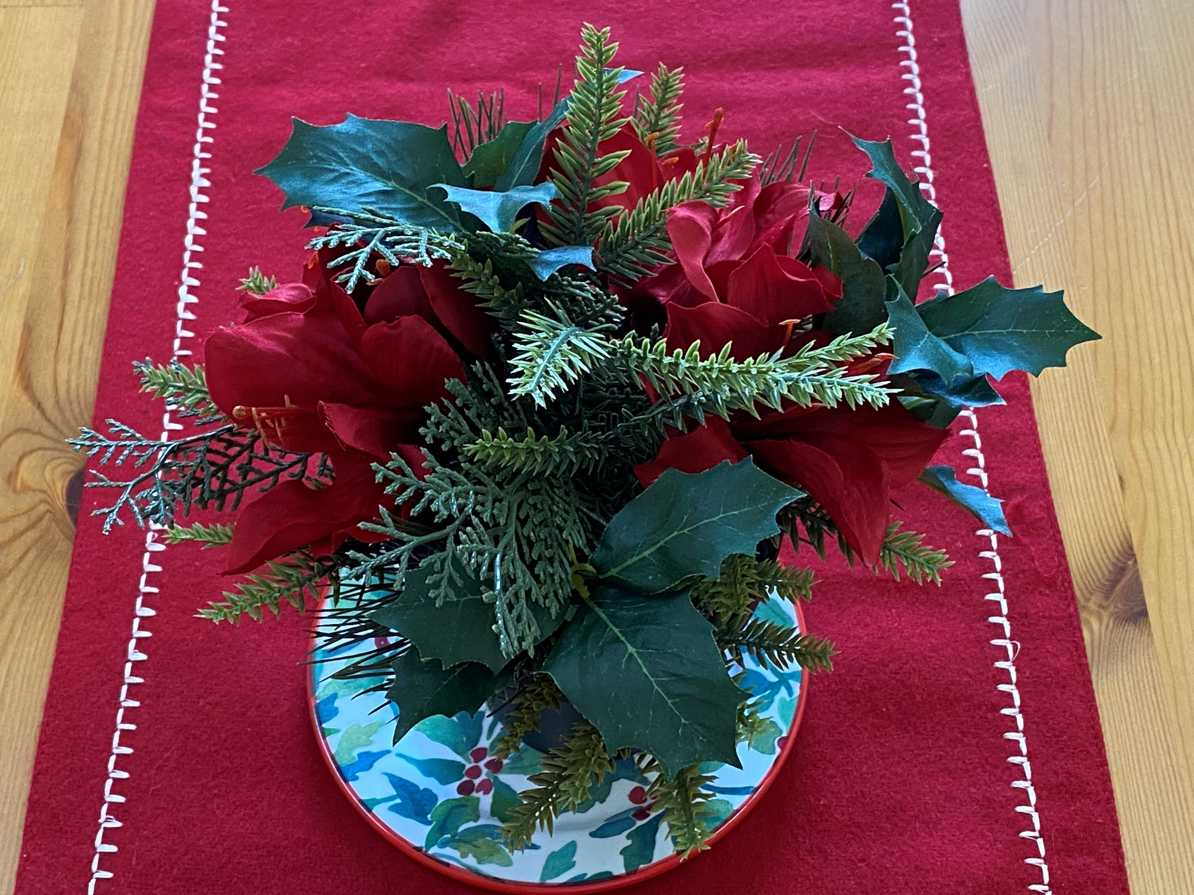
Welcome
Christmas!

Slide 2
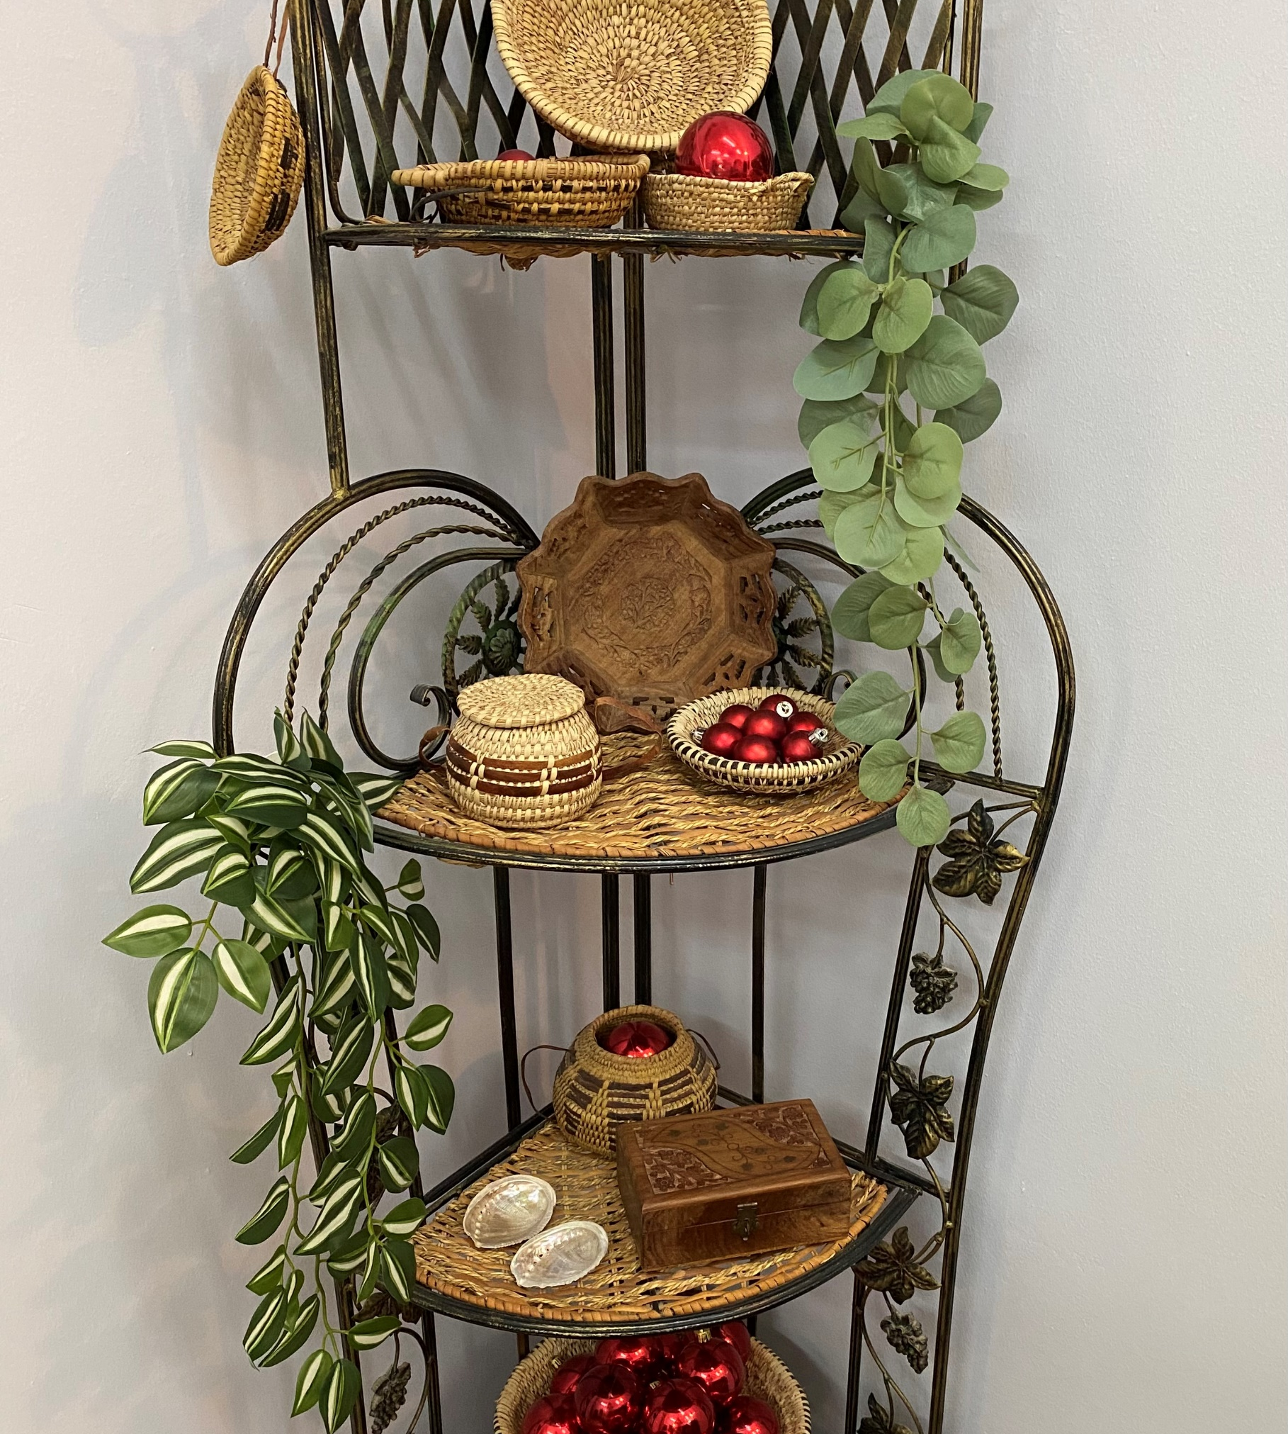
I am so sorry you won’t be getting a hand-painted Christmas card but it’s been a difficult fall, not to mention that cough syrup, Marielle and painting is a bad combination!
Please allow me to make it up to you with a super helpful powerpoint about Christmas decorating!

Slide 3
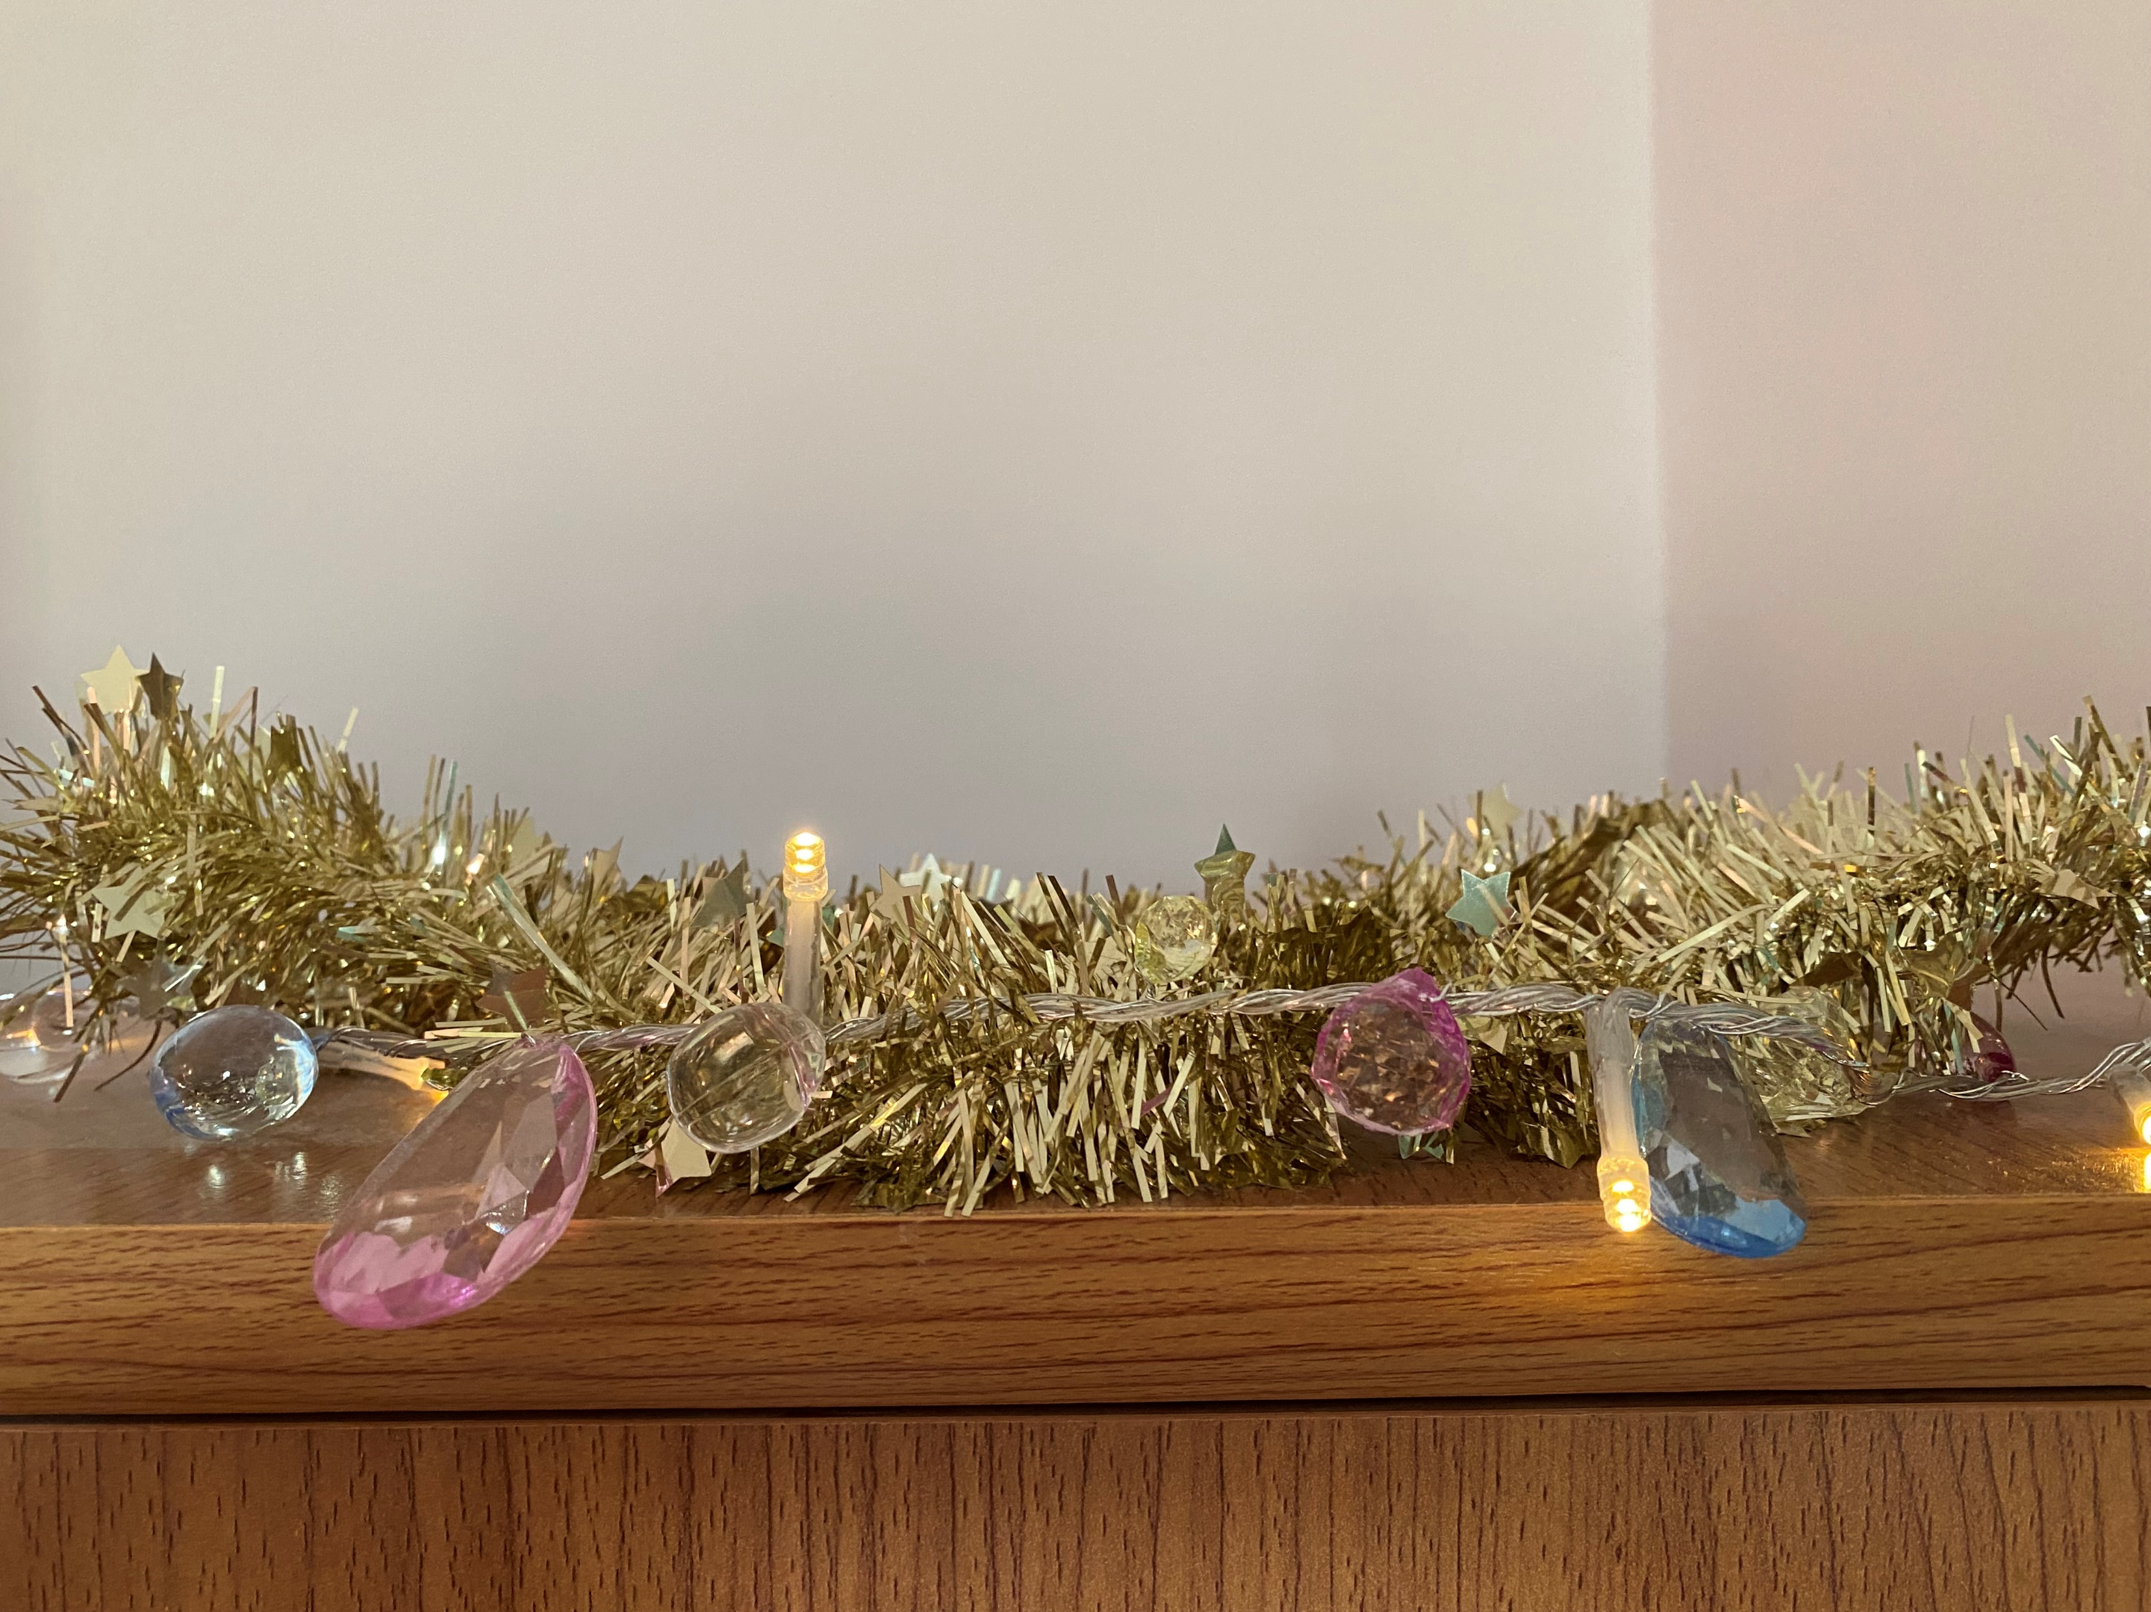
First, take your string of fairy lights with fake jewels and twist a gold… wait…
You DON’T have a string of fairy lights with fake jewels… really? Huh. Odd.

Slide 4
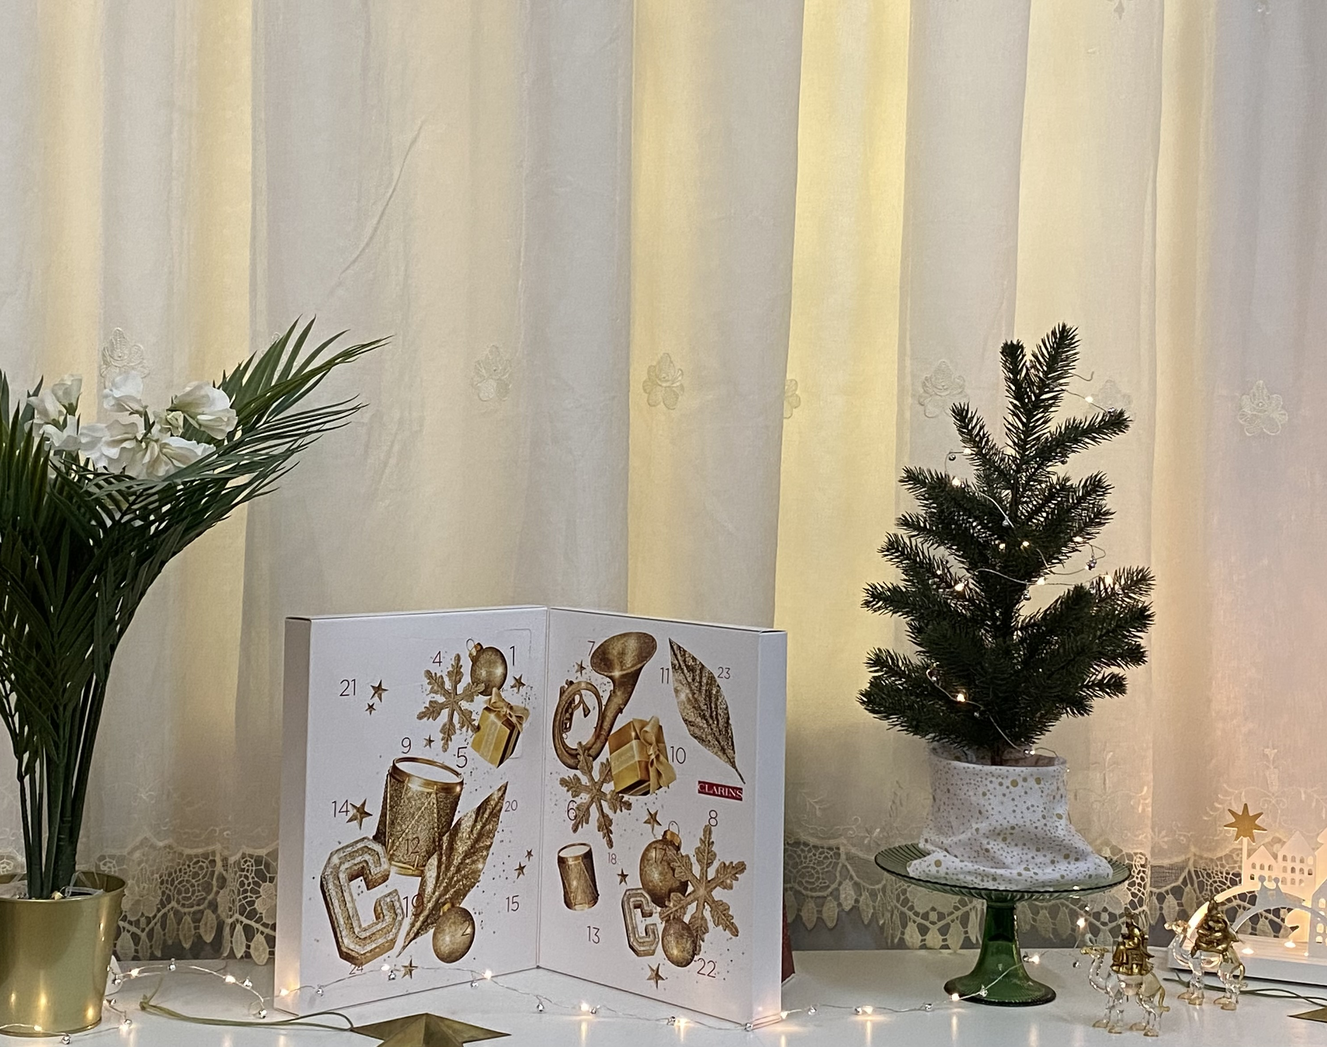
Not to worry, start with putting your mini-fake tree on a green glass pedestal and stick white orchids into your mini-palm tree…
No green glass pedestal?
No mini-palm?
Oh…Well…

Slide 5

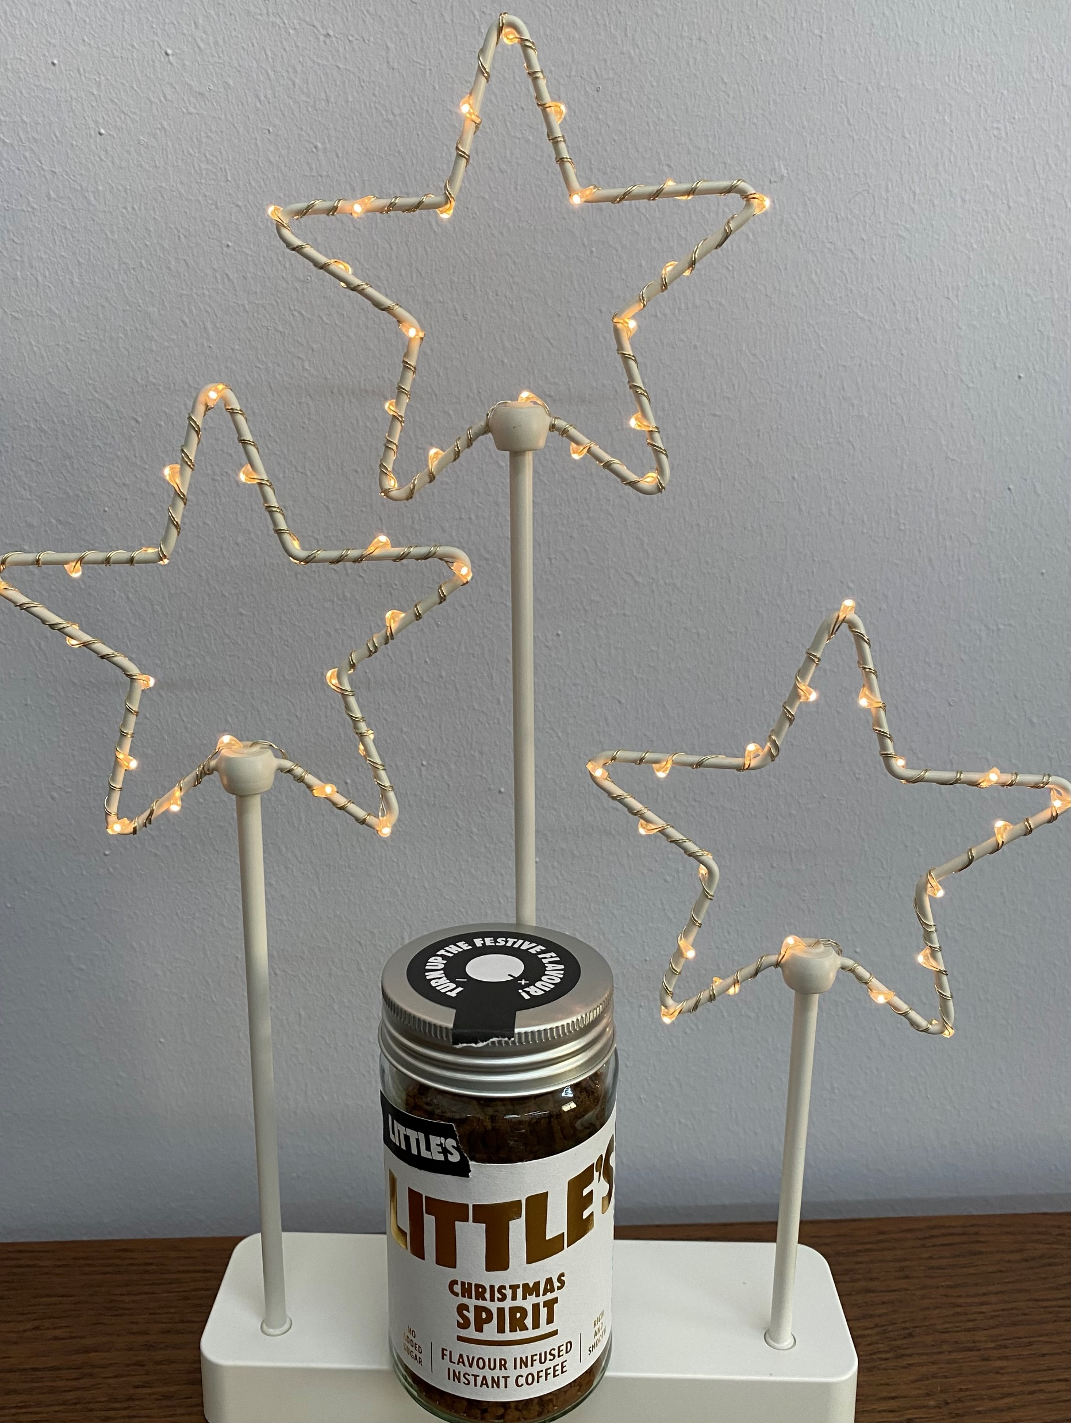
Ok, we’ll skip that step, take your shiny positivity mug and fill it with Christmas spirit coffee… What? You don’t have a shiny positivity mug? You don’t have Christmas spirit coffee? Well, you might as well say that you don’t have a pink decorated tree that matches your earrings!

Slide 6
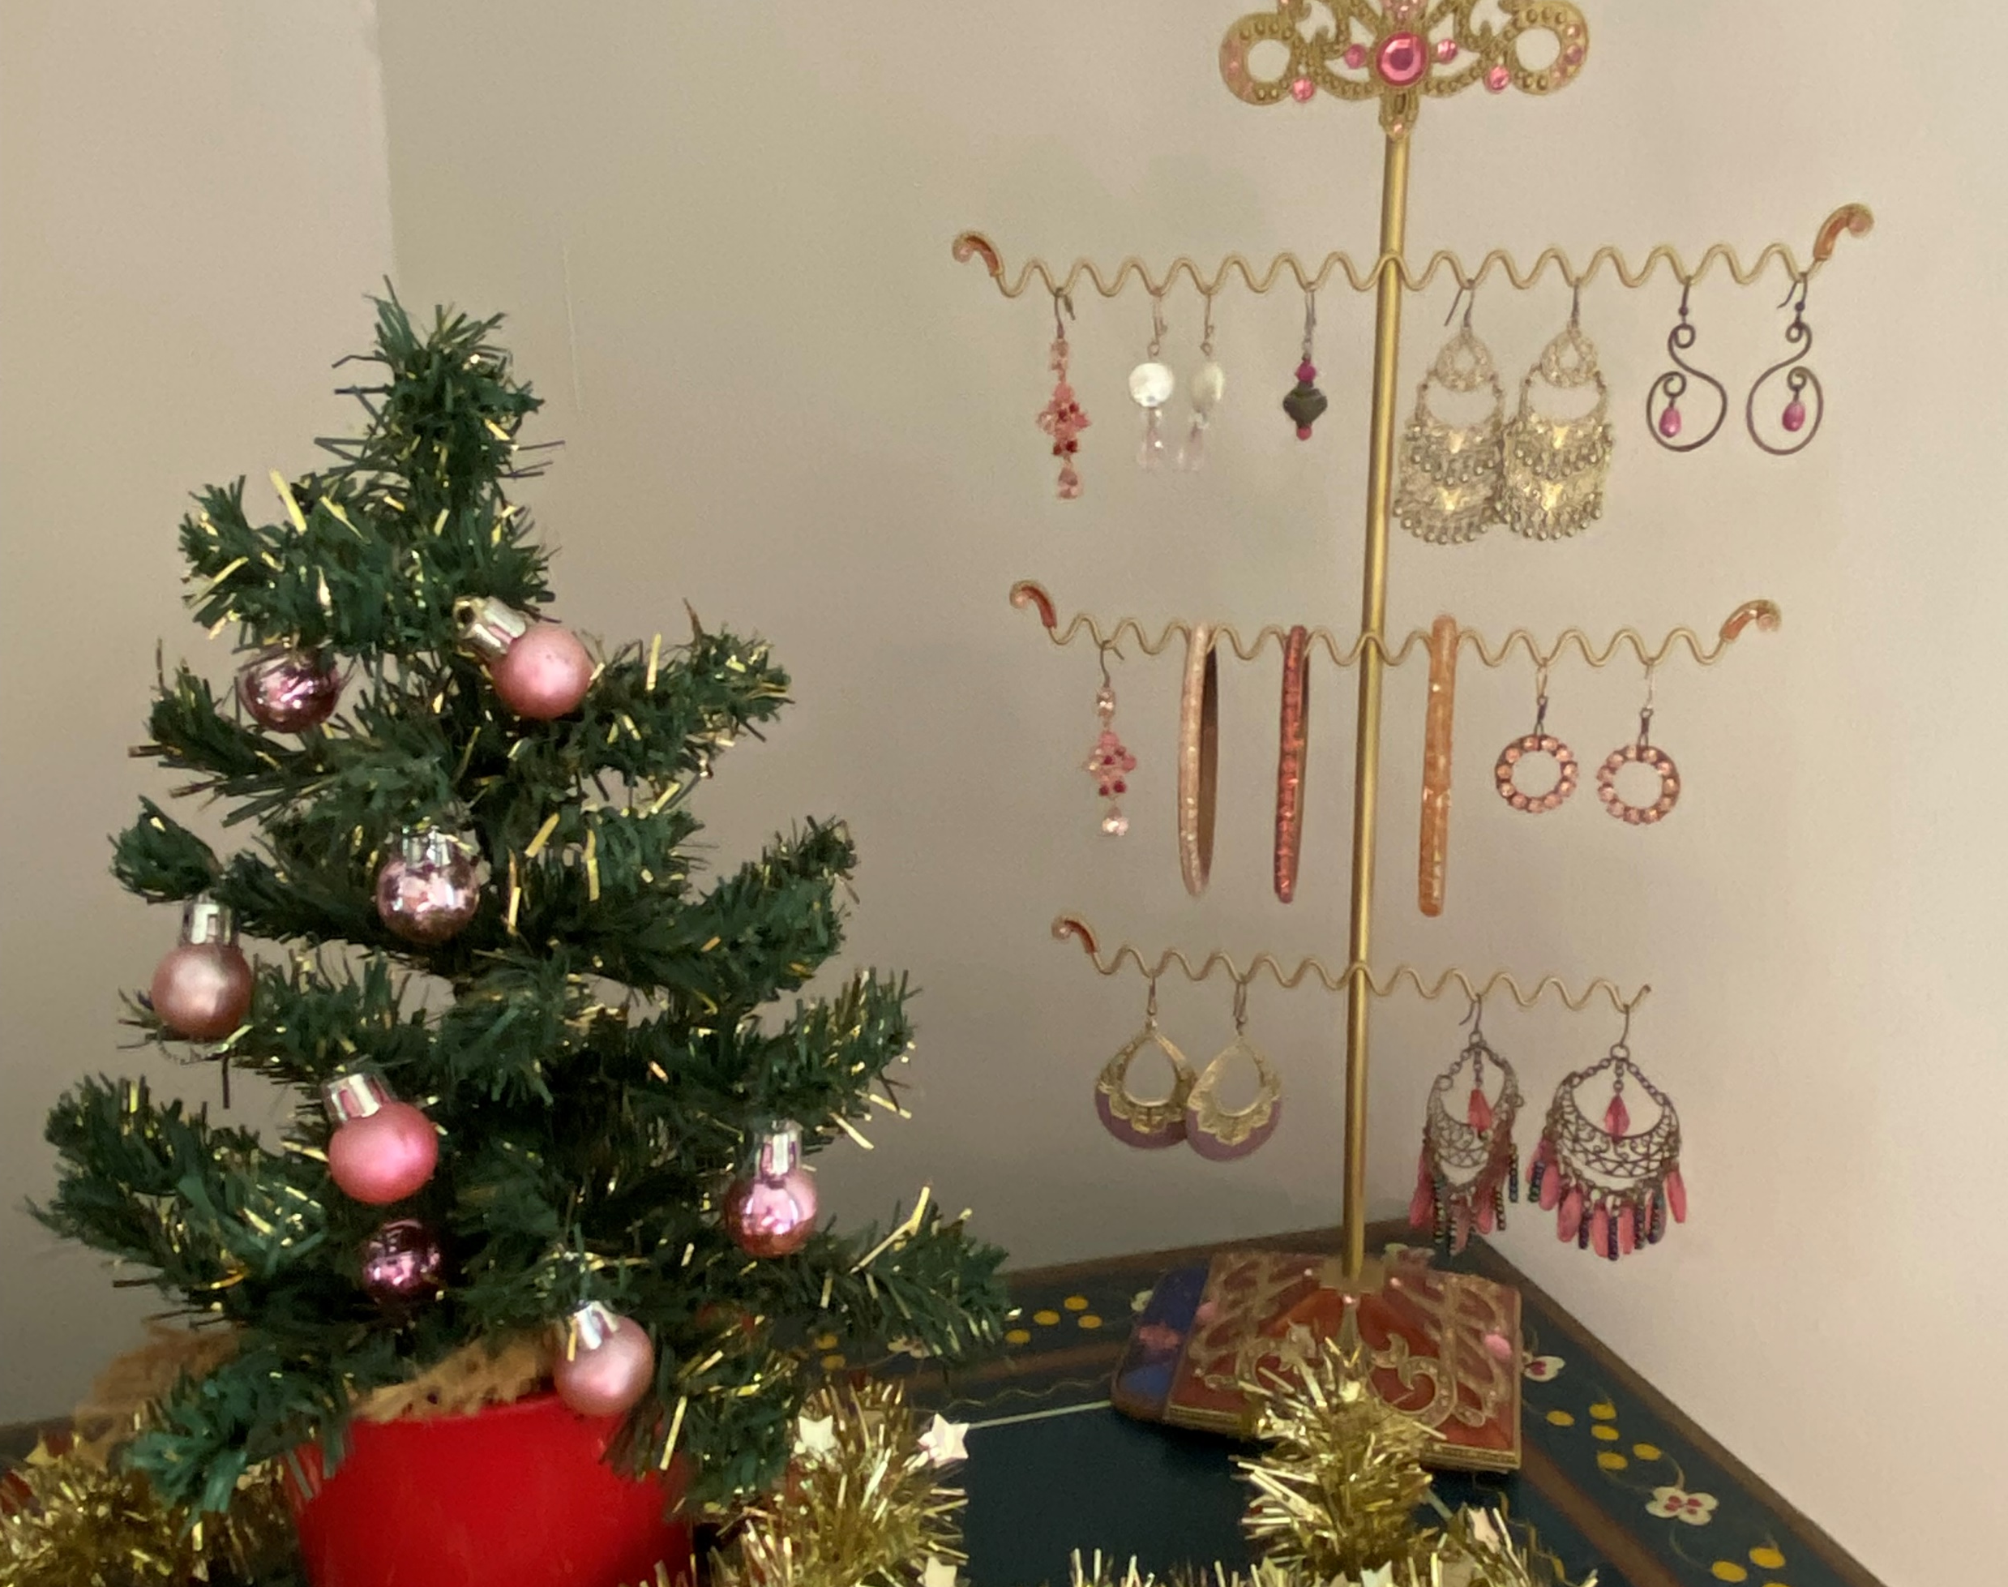
WHAT? No pink decorated tree that matches your earring??
Have I taught you nothing??
Have not you NOT been listening???

Slide 7
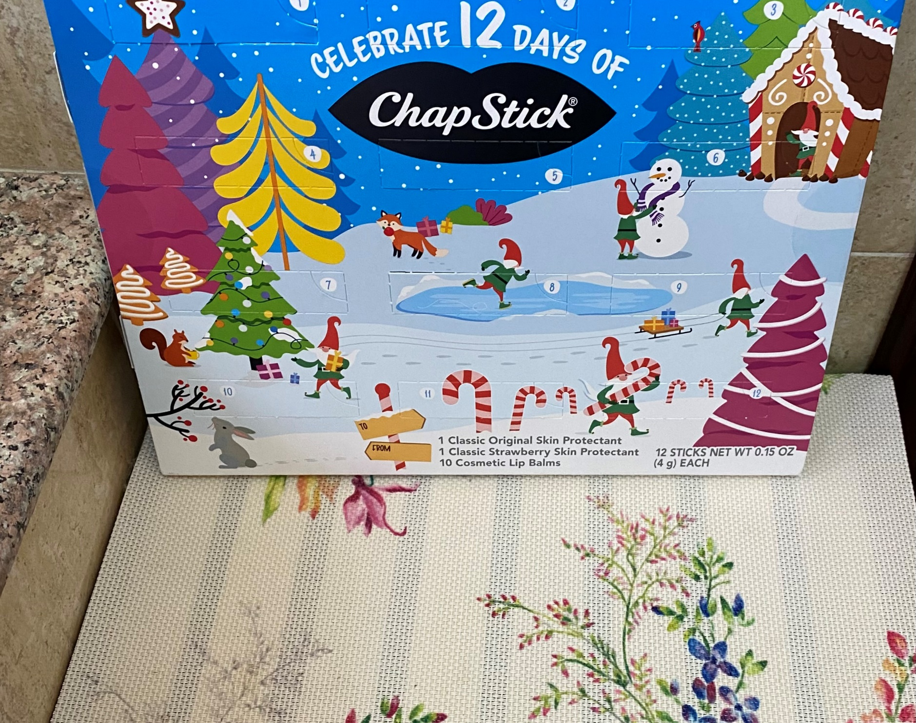
Good grief!
Deep breath!
We regroup.
We start over. We go super simple. Take your Chapstick advent calendar… WHAT????? NO CHAPSTICK ADVENT CALENDAR?
How do you call yourself human?

Slide 8
I give up.
Go be Norwegian and decorate with white lights and black twigs.
See if I care.
Sit in your unsparkled, dull living room with nary a twinkle in sight.
See if Santa wants to visit you with your prune juice and porridge.

Slide 9
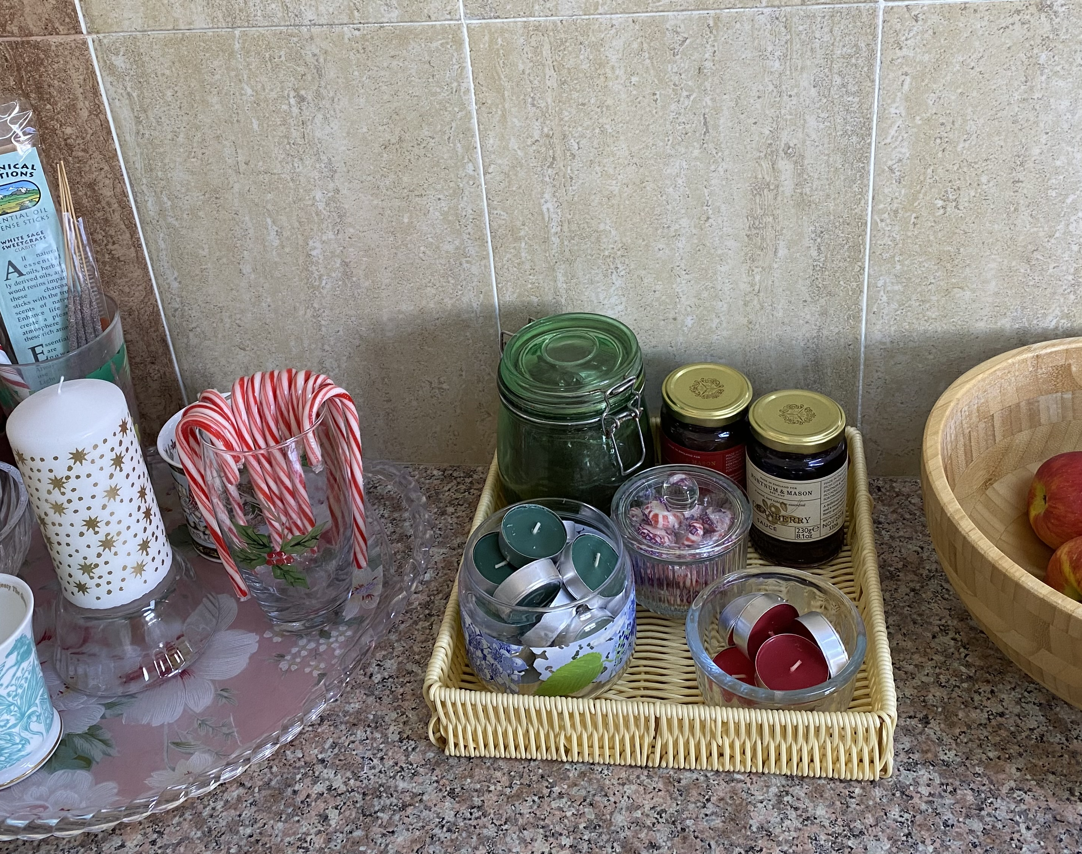
No, no, it’s Christmas!
One must be generous and charitable, even to those without shiny positivity mugs.
Allow me elucidate.
Here is how we do christmas spirit!

Slide 10
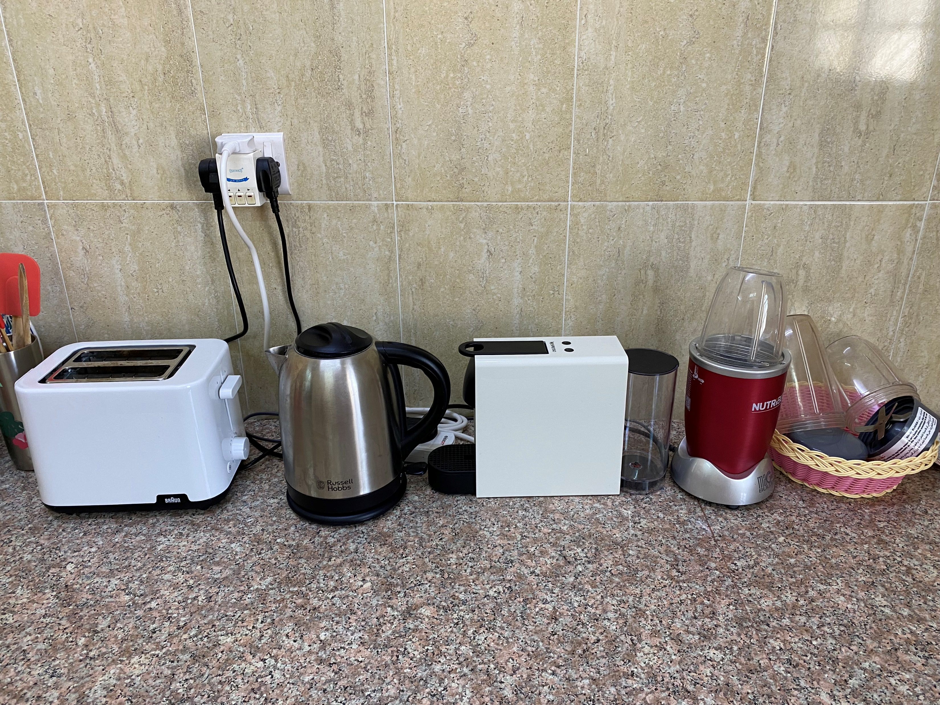
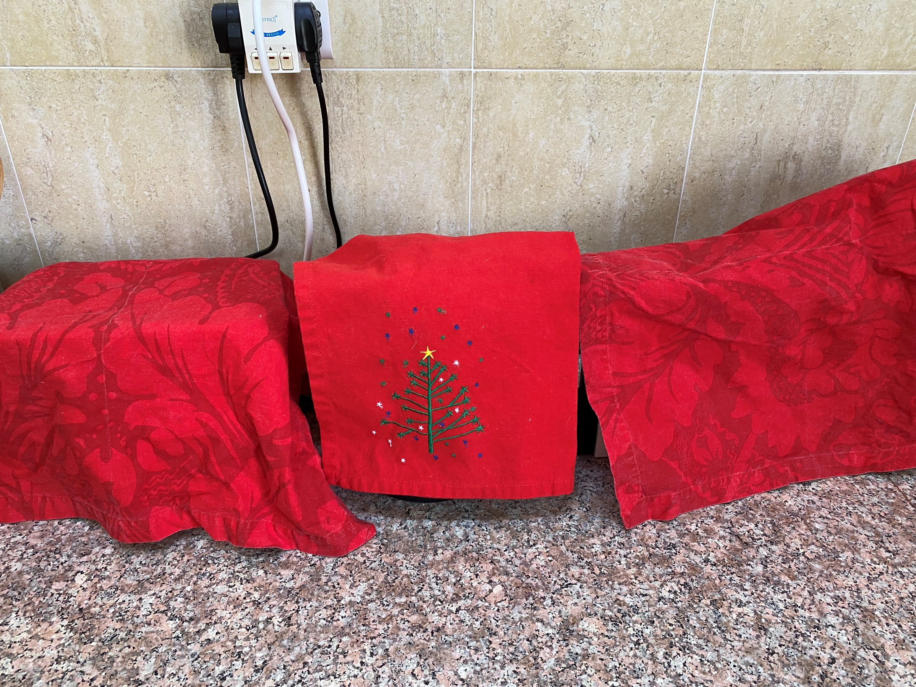
C is for - Cover your appliances!

Slide 11
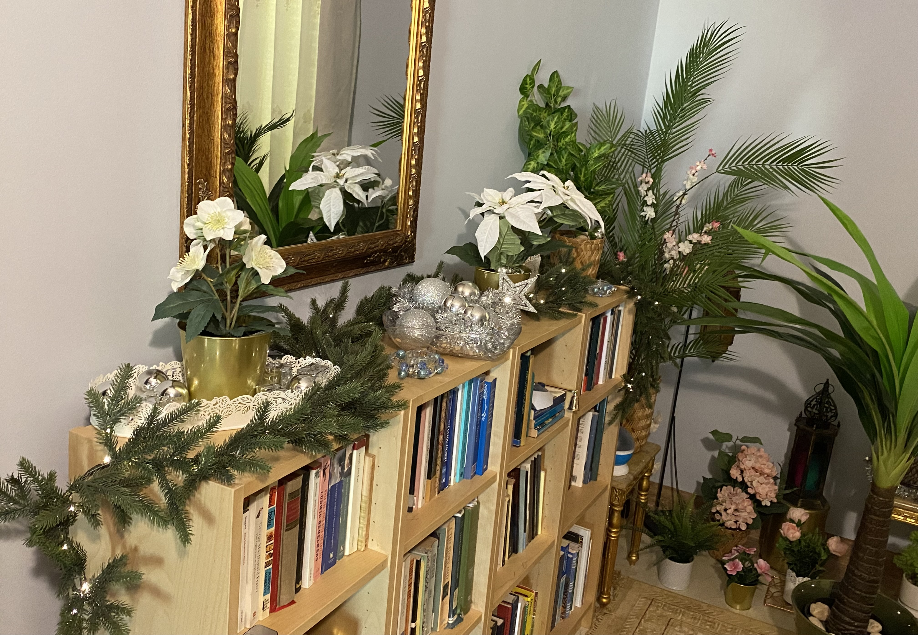
H is for – How do you live without fake garlands?

Slide 12
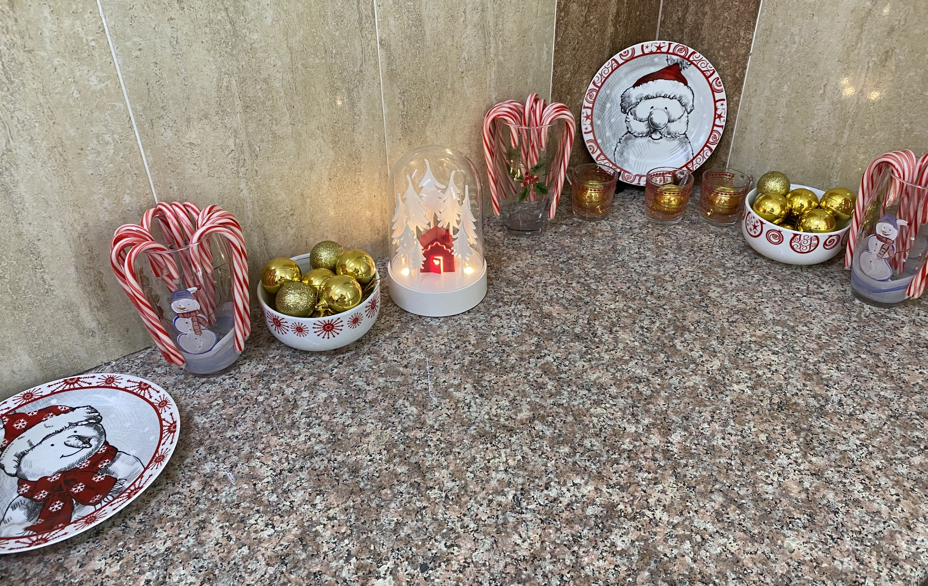
R is for –
Really overdecorate the kitchen counter!

Slide 13
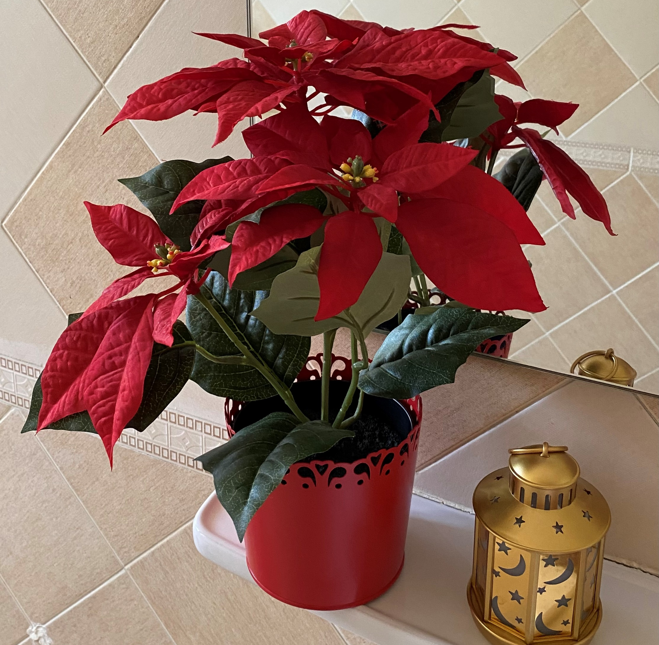
I is for
I am so happy IKEA has fake poinsettias!

Slide 14
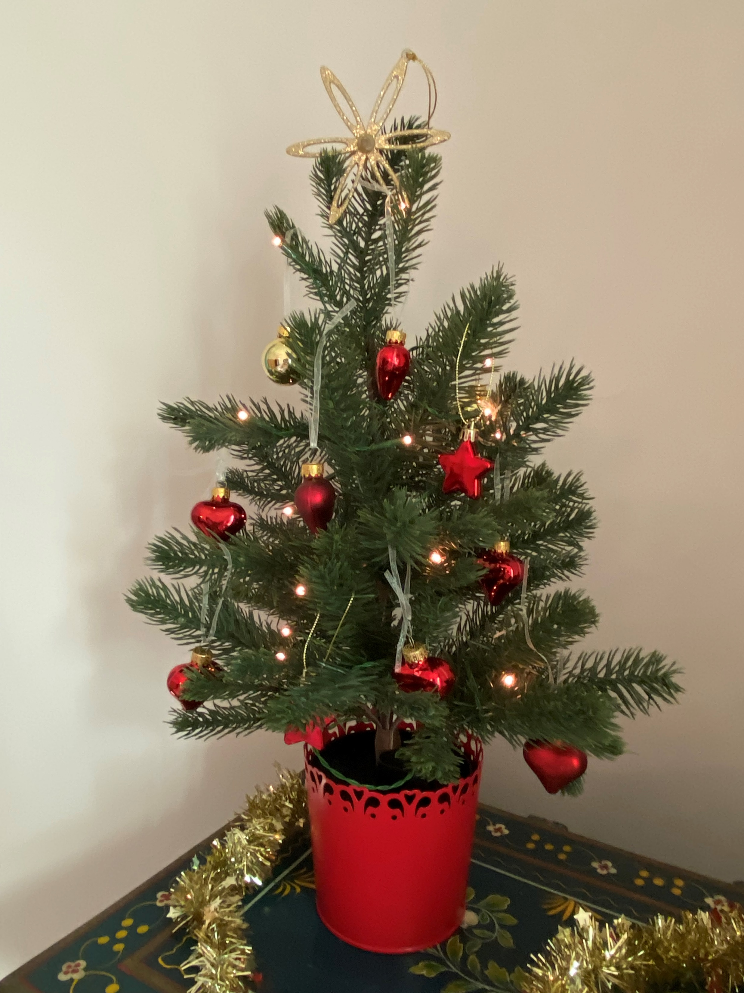
S is for
Stars and hearts!

Slide 15
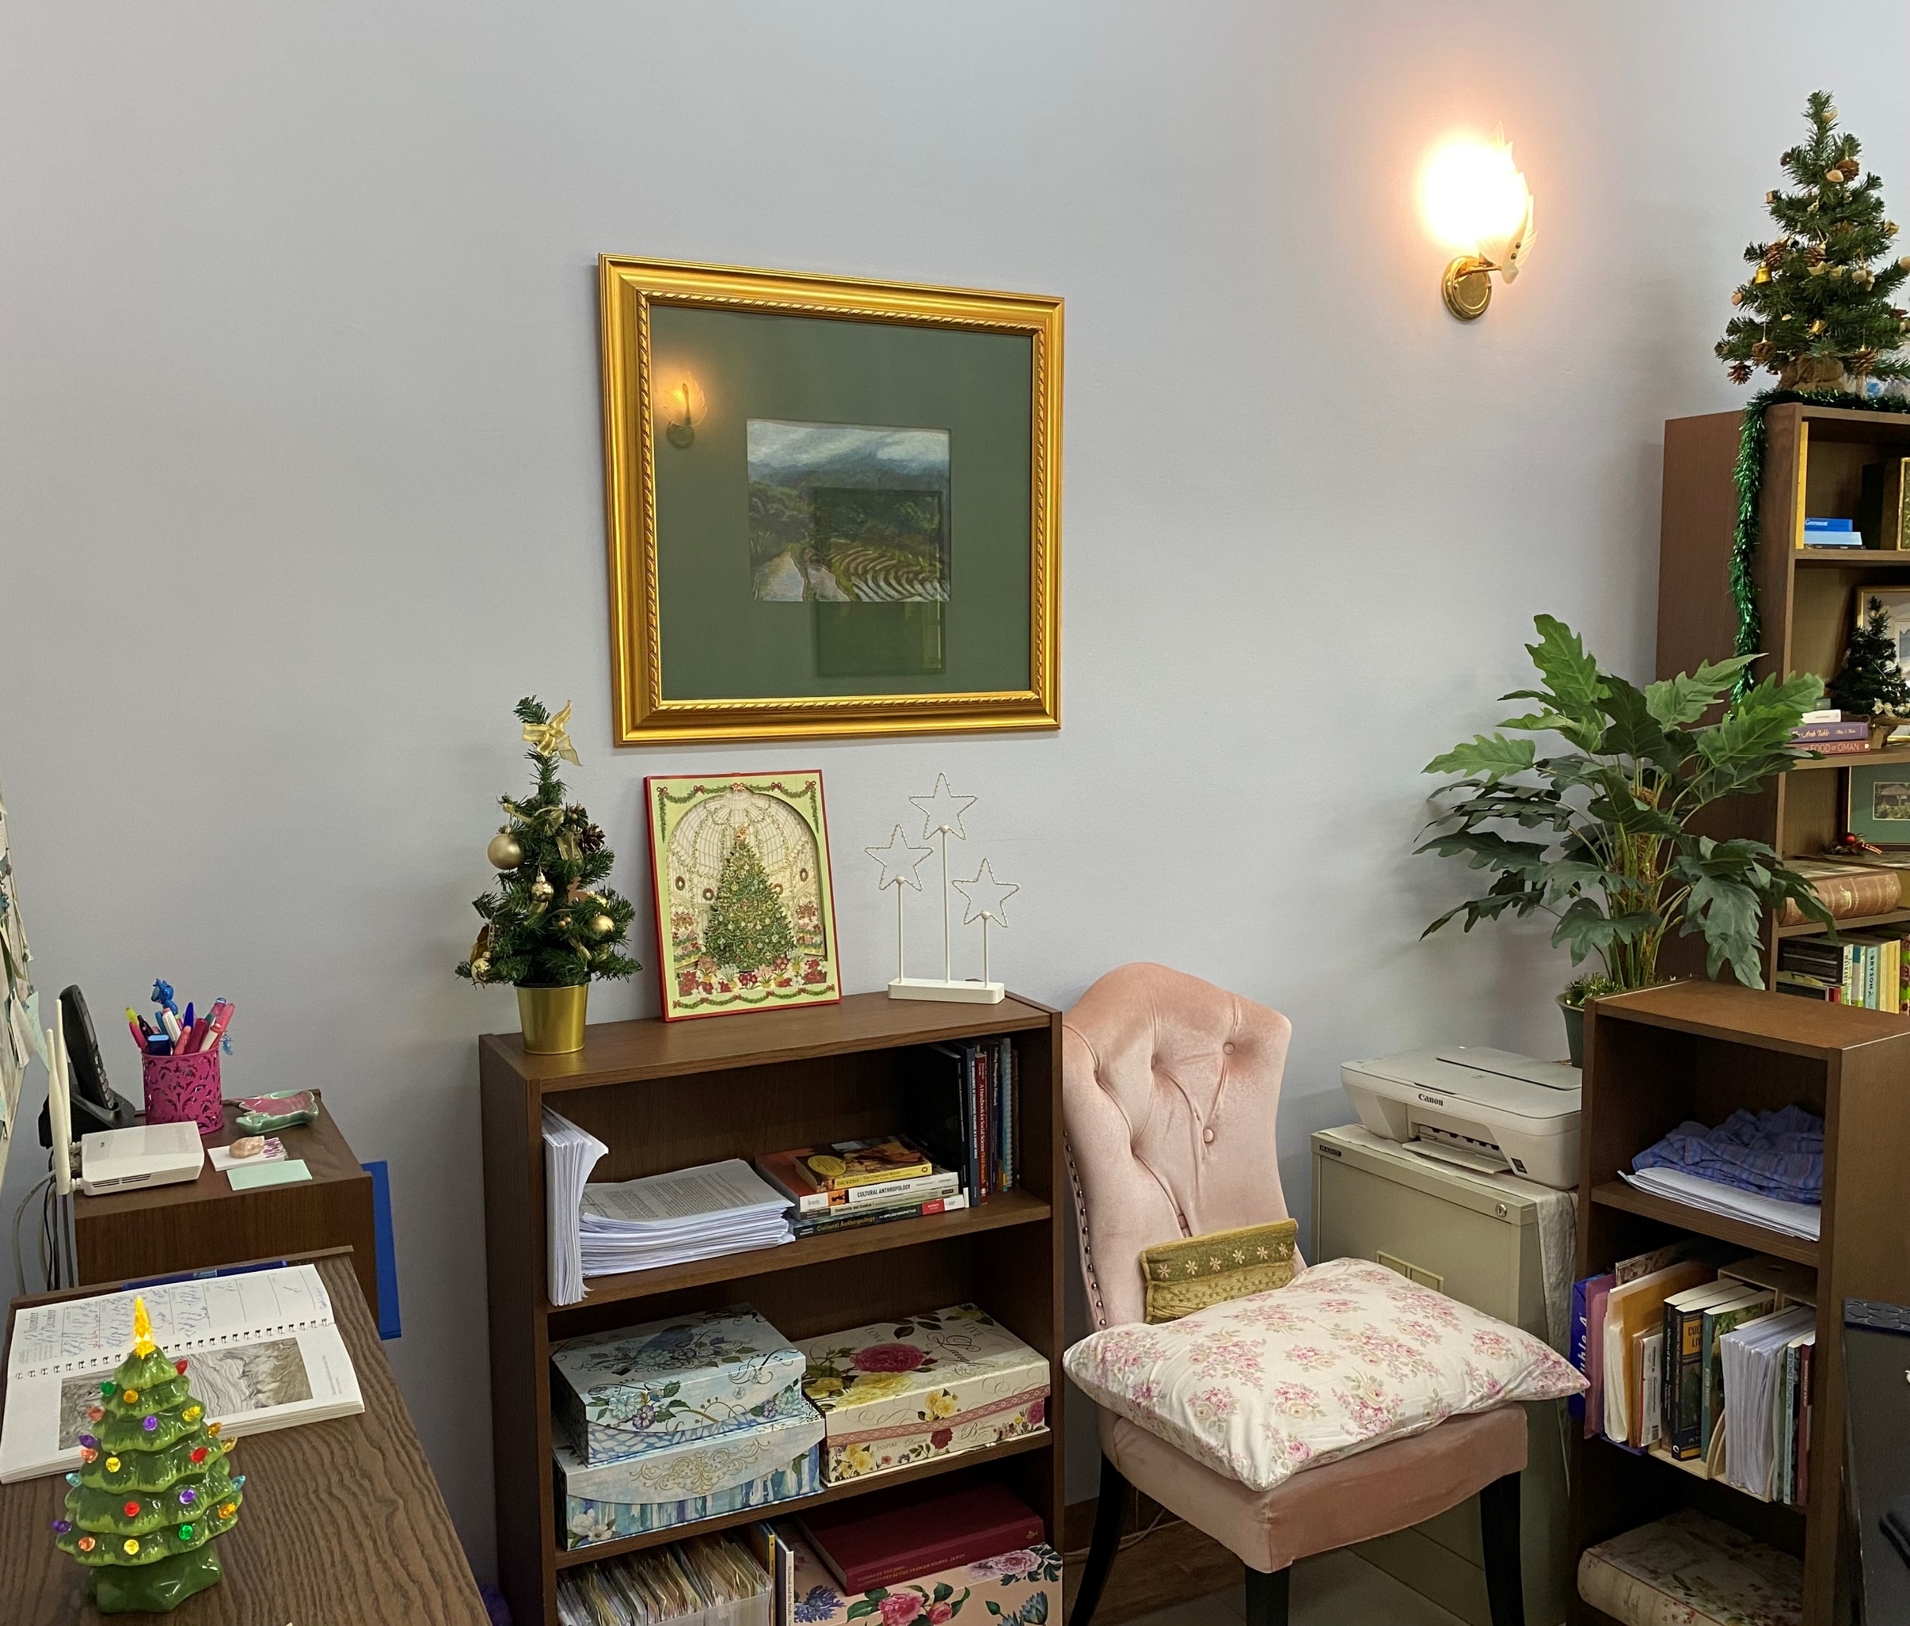
T is for -
Trees everywhere!

Slide 16
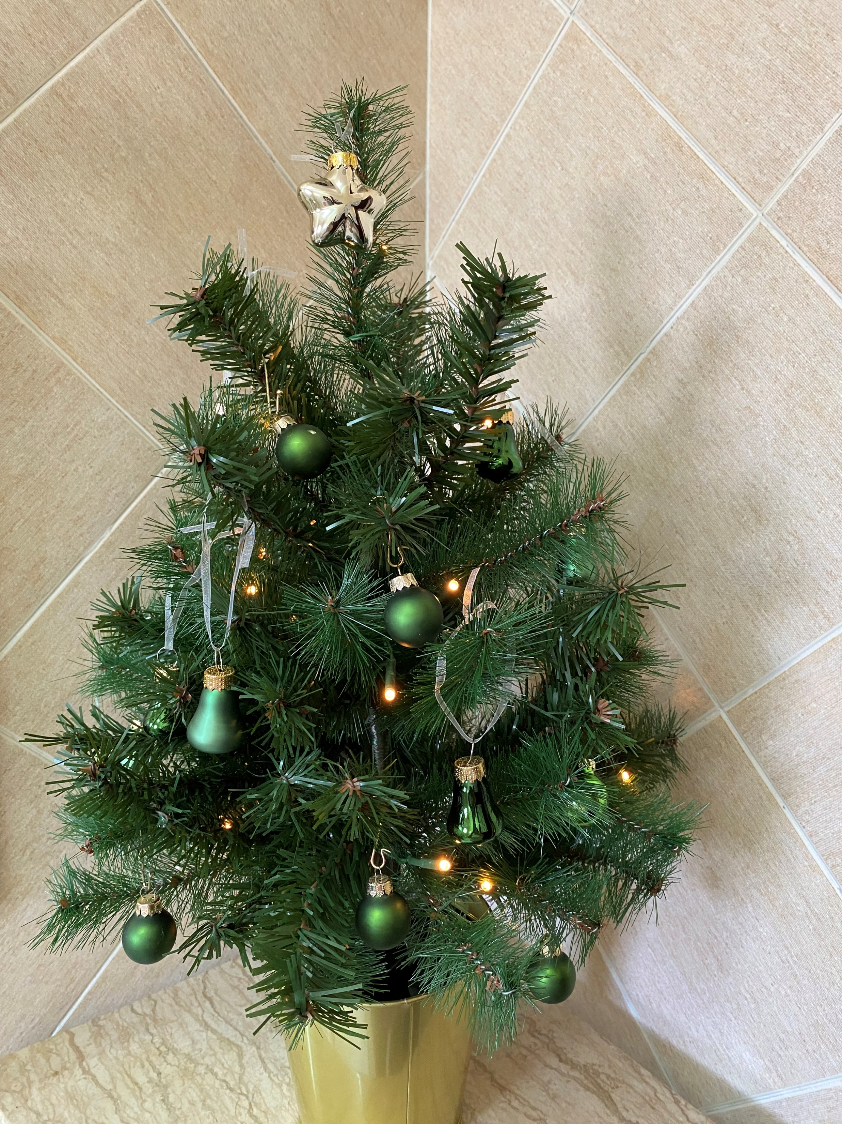
M is for -
Must have tree, even in bathroom!

Slide 17
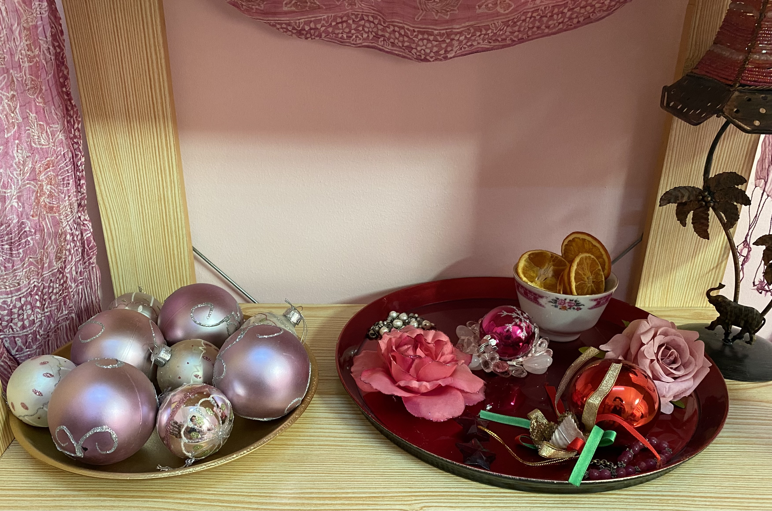
A is for -
Always use pink!

Slide 18
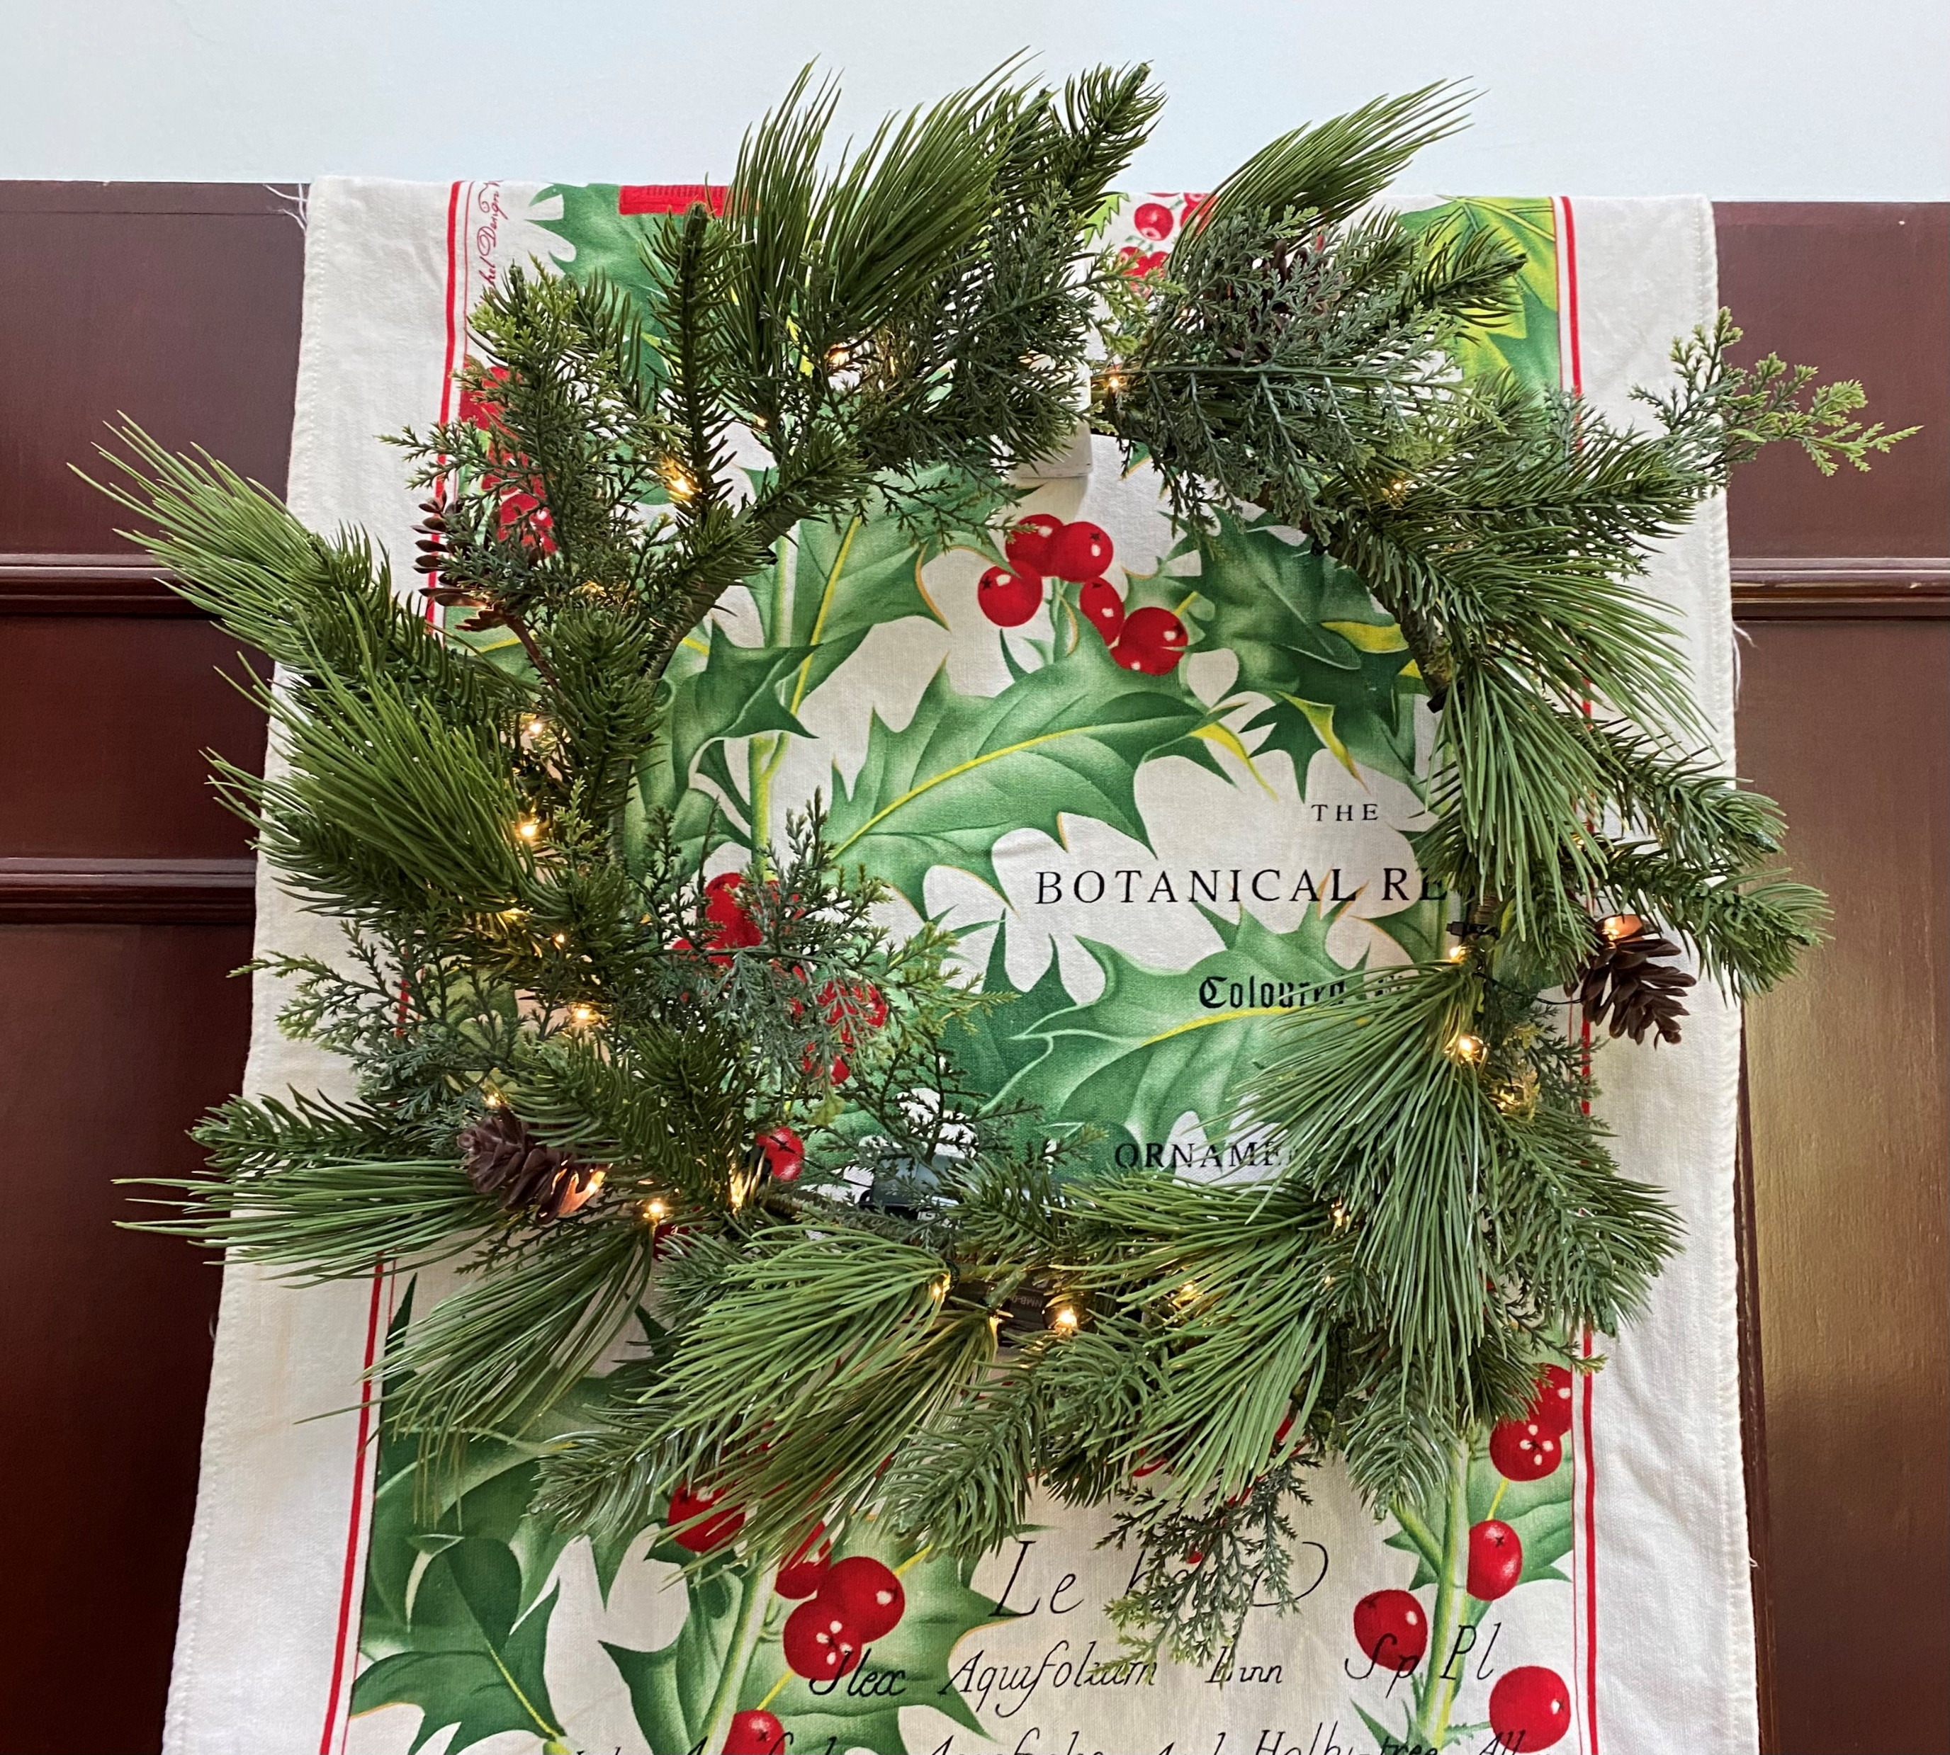
S is for -
Swedes can be sanctimonious but we are grateful for IKEA!

Slide 19
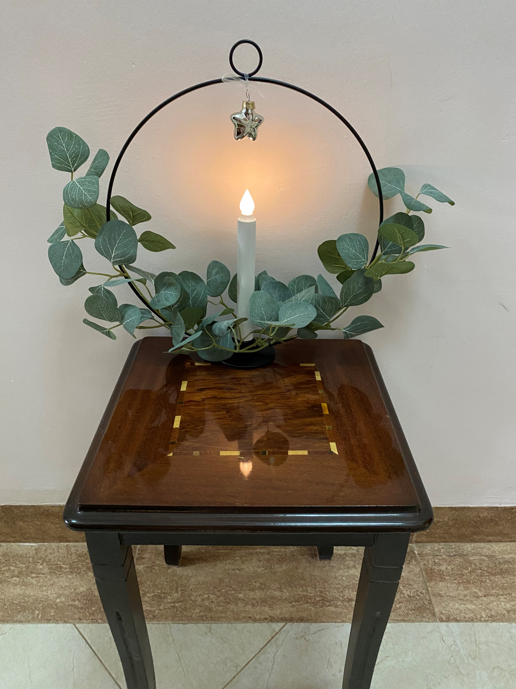
S is for -
Shining candle!

Slide 20
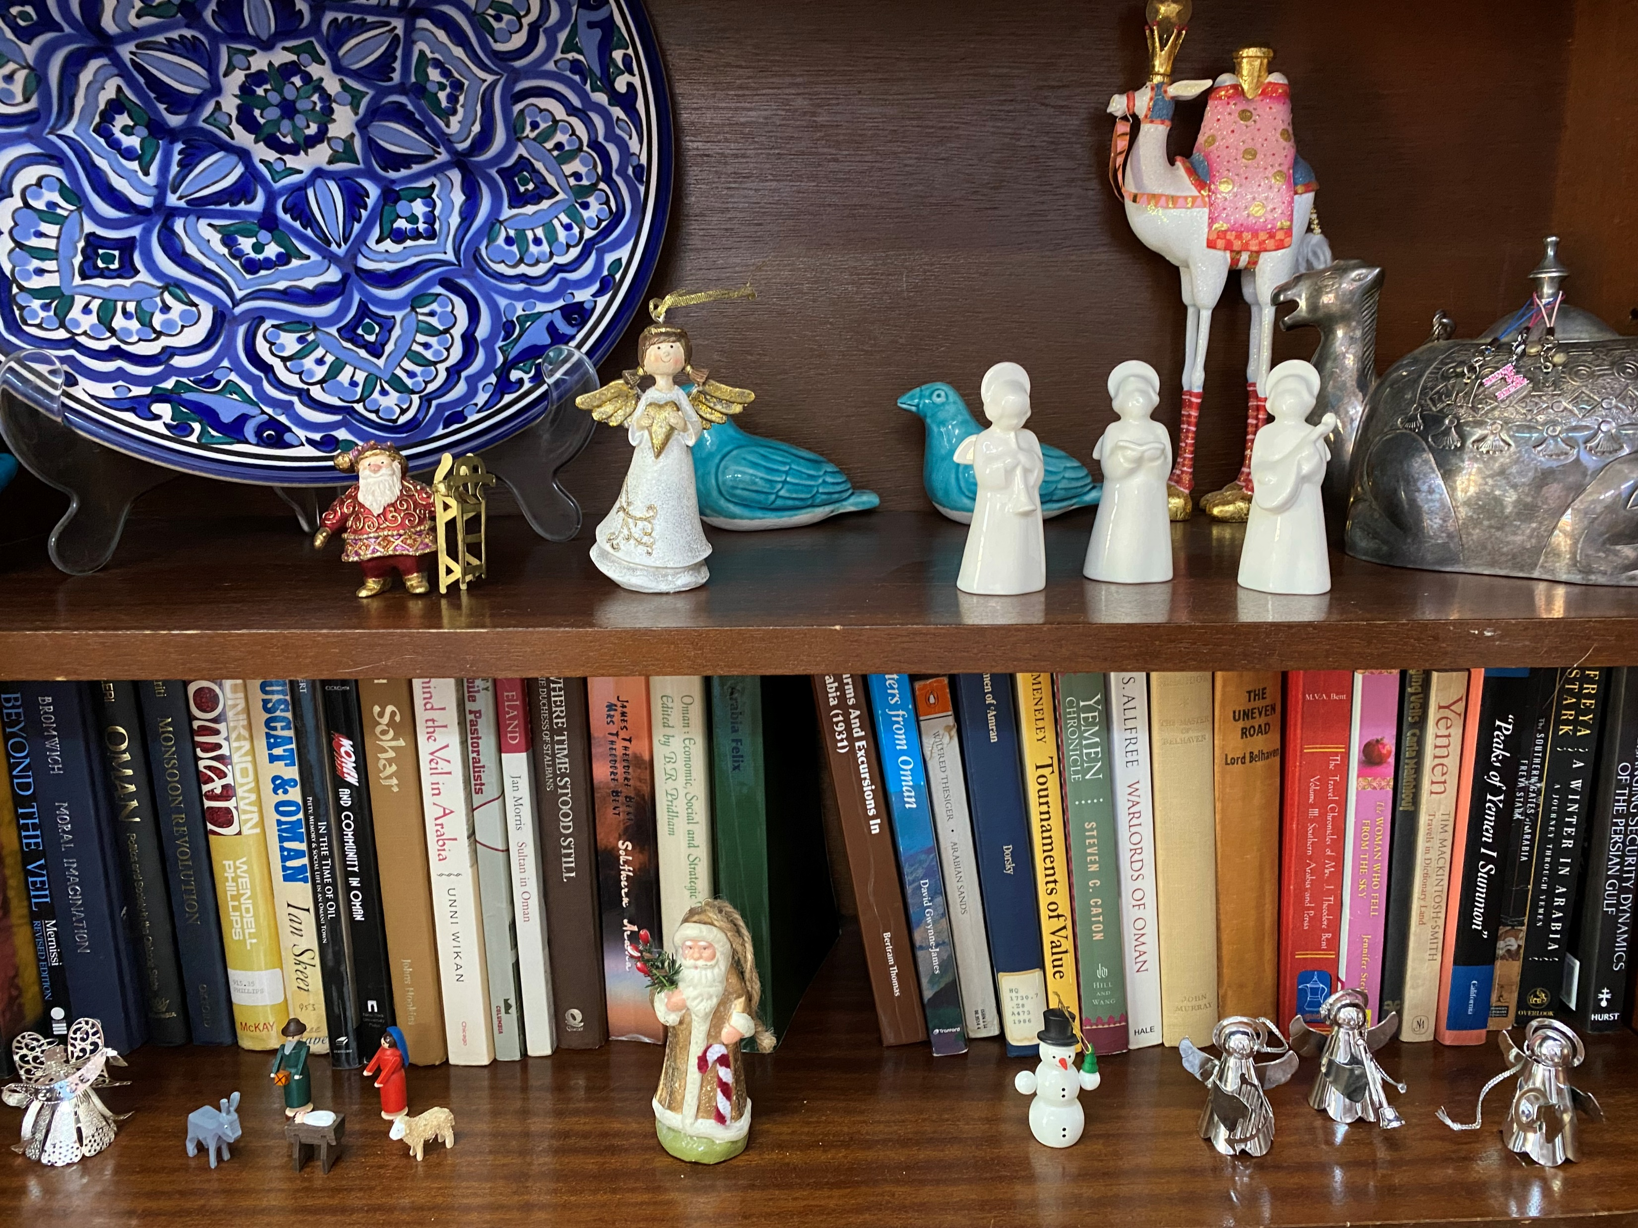
P is for -
Pretty!

Slide 21
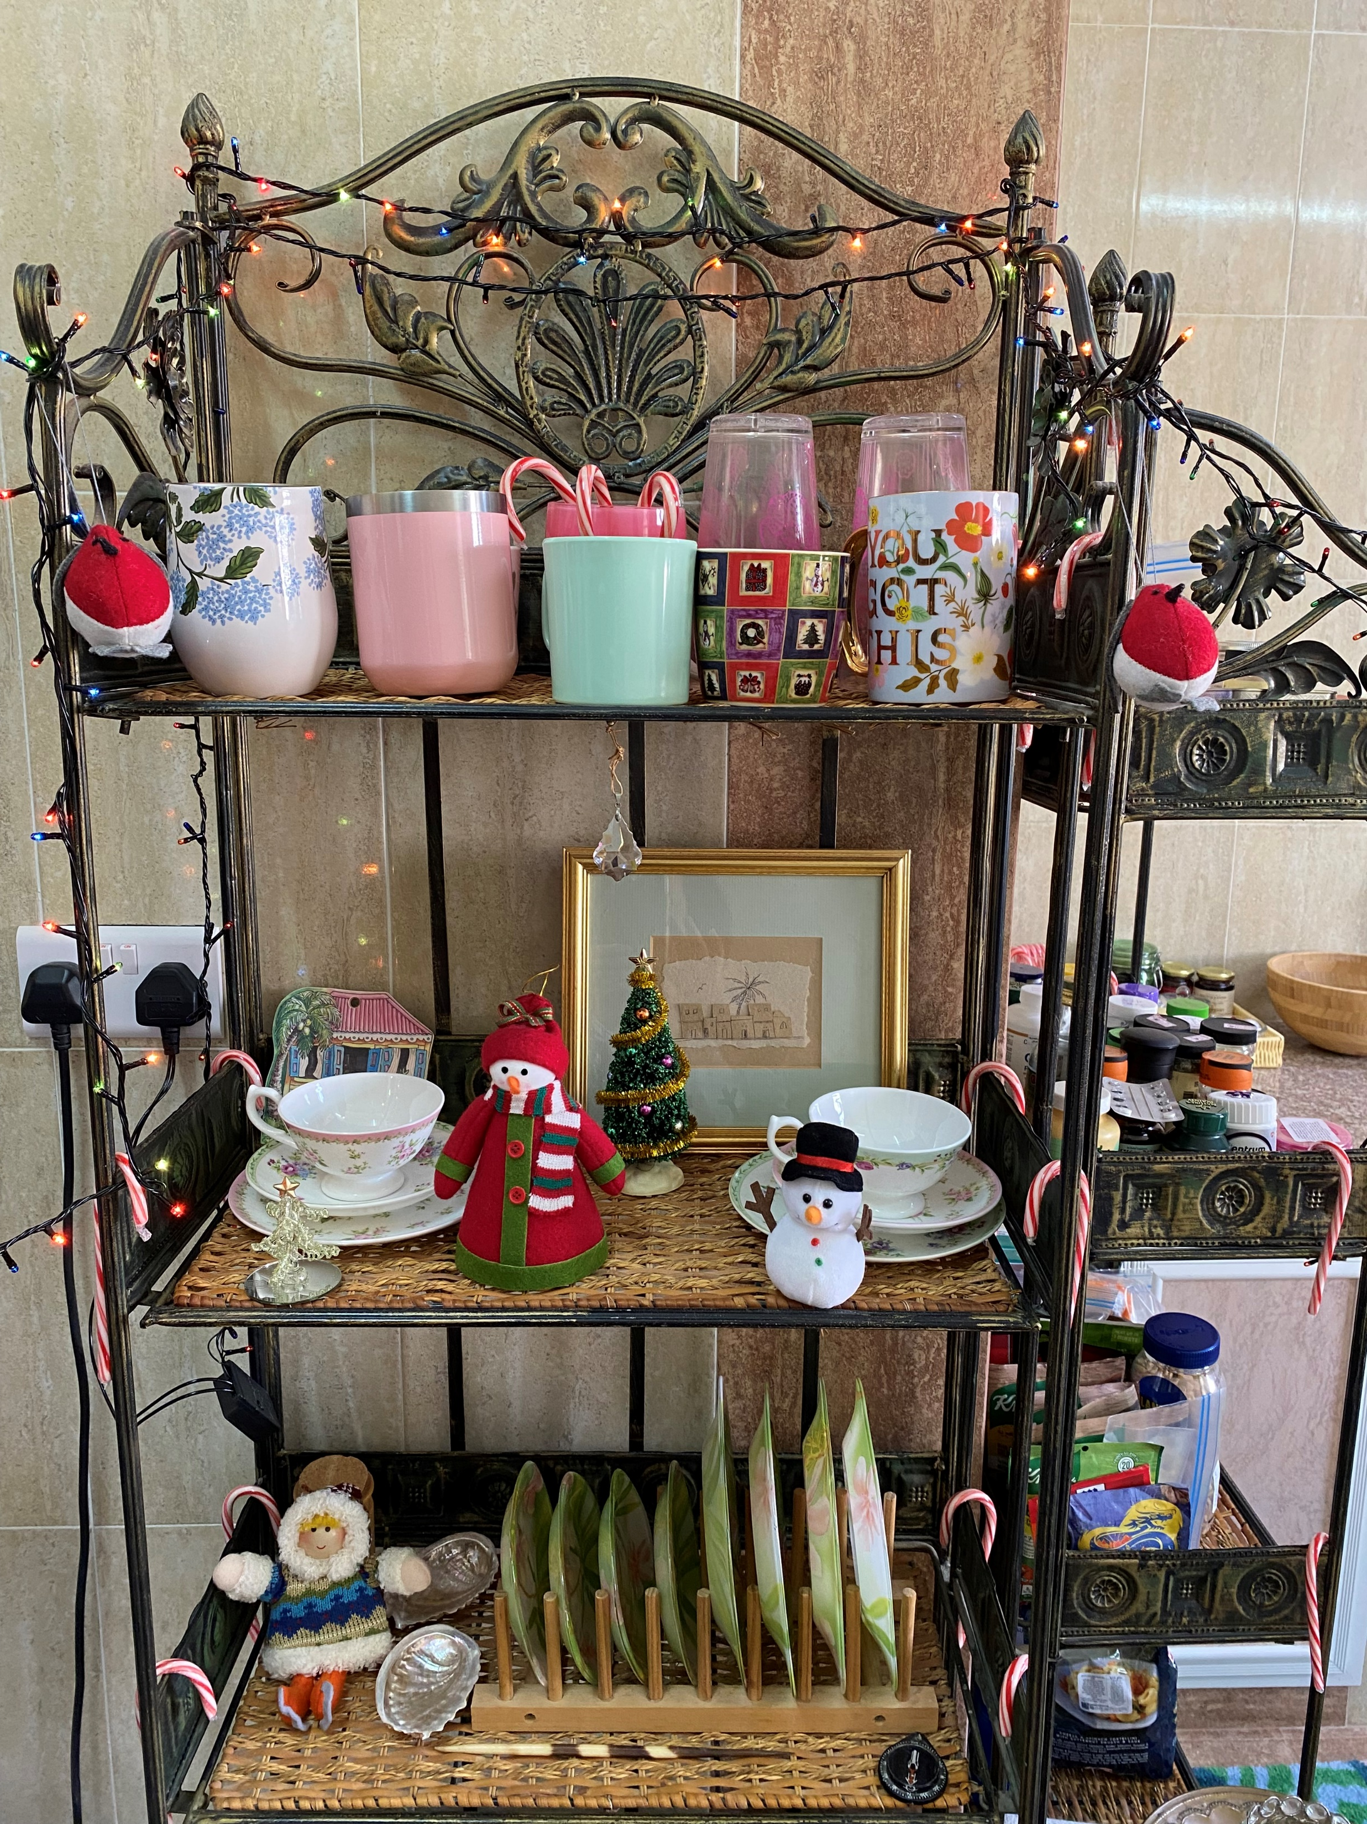
I is for -
If it does not move, adorn it!

Slide 22
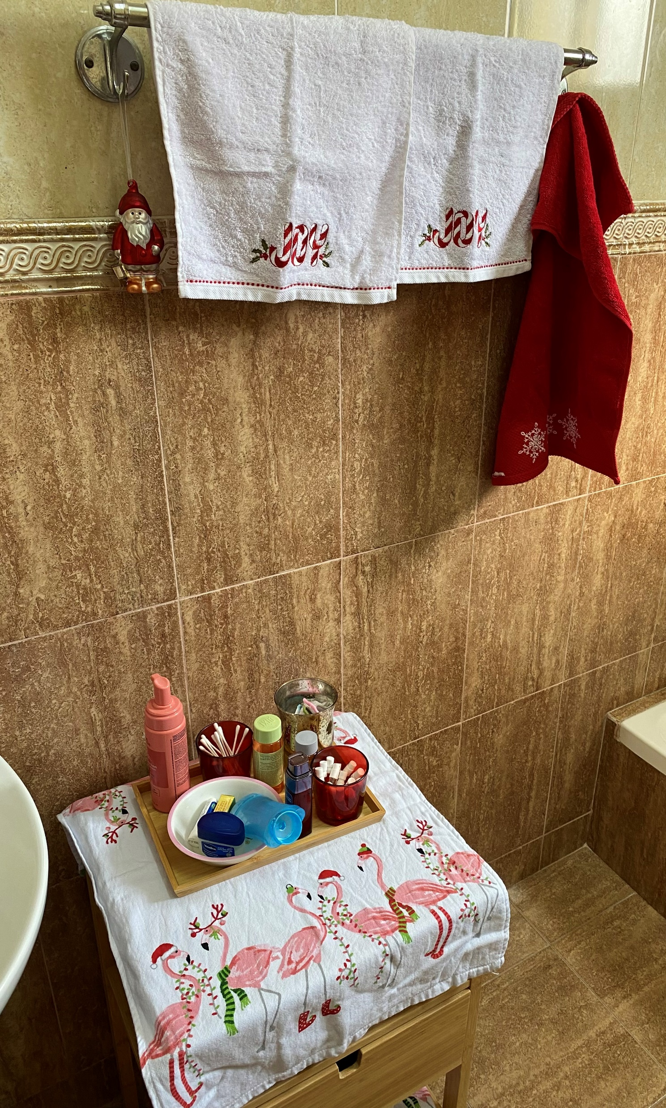
R is for –
Really need
Flamingos in
Santa hats!

Slide 23
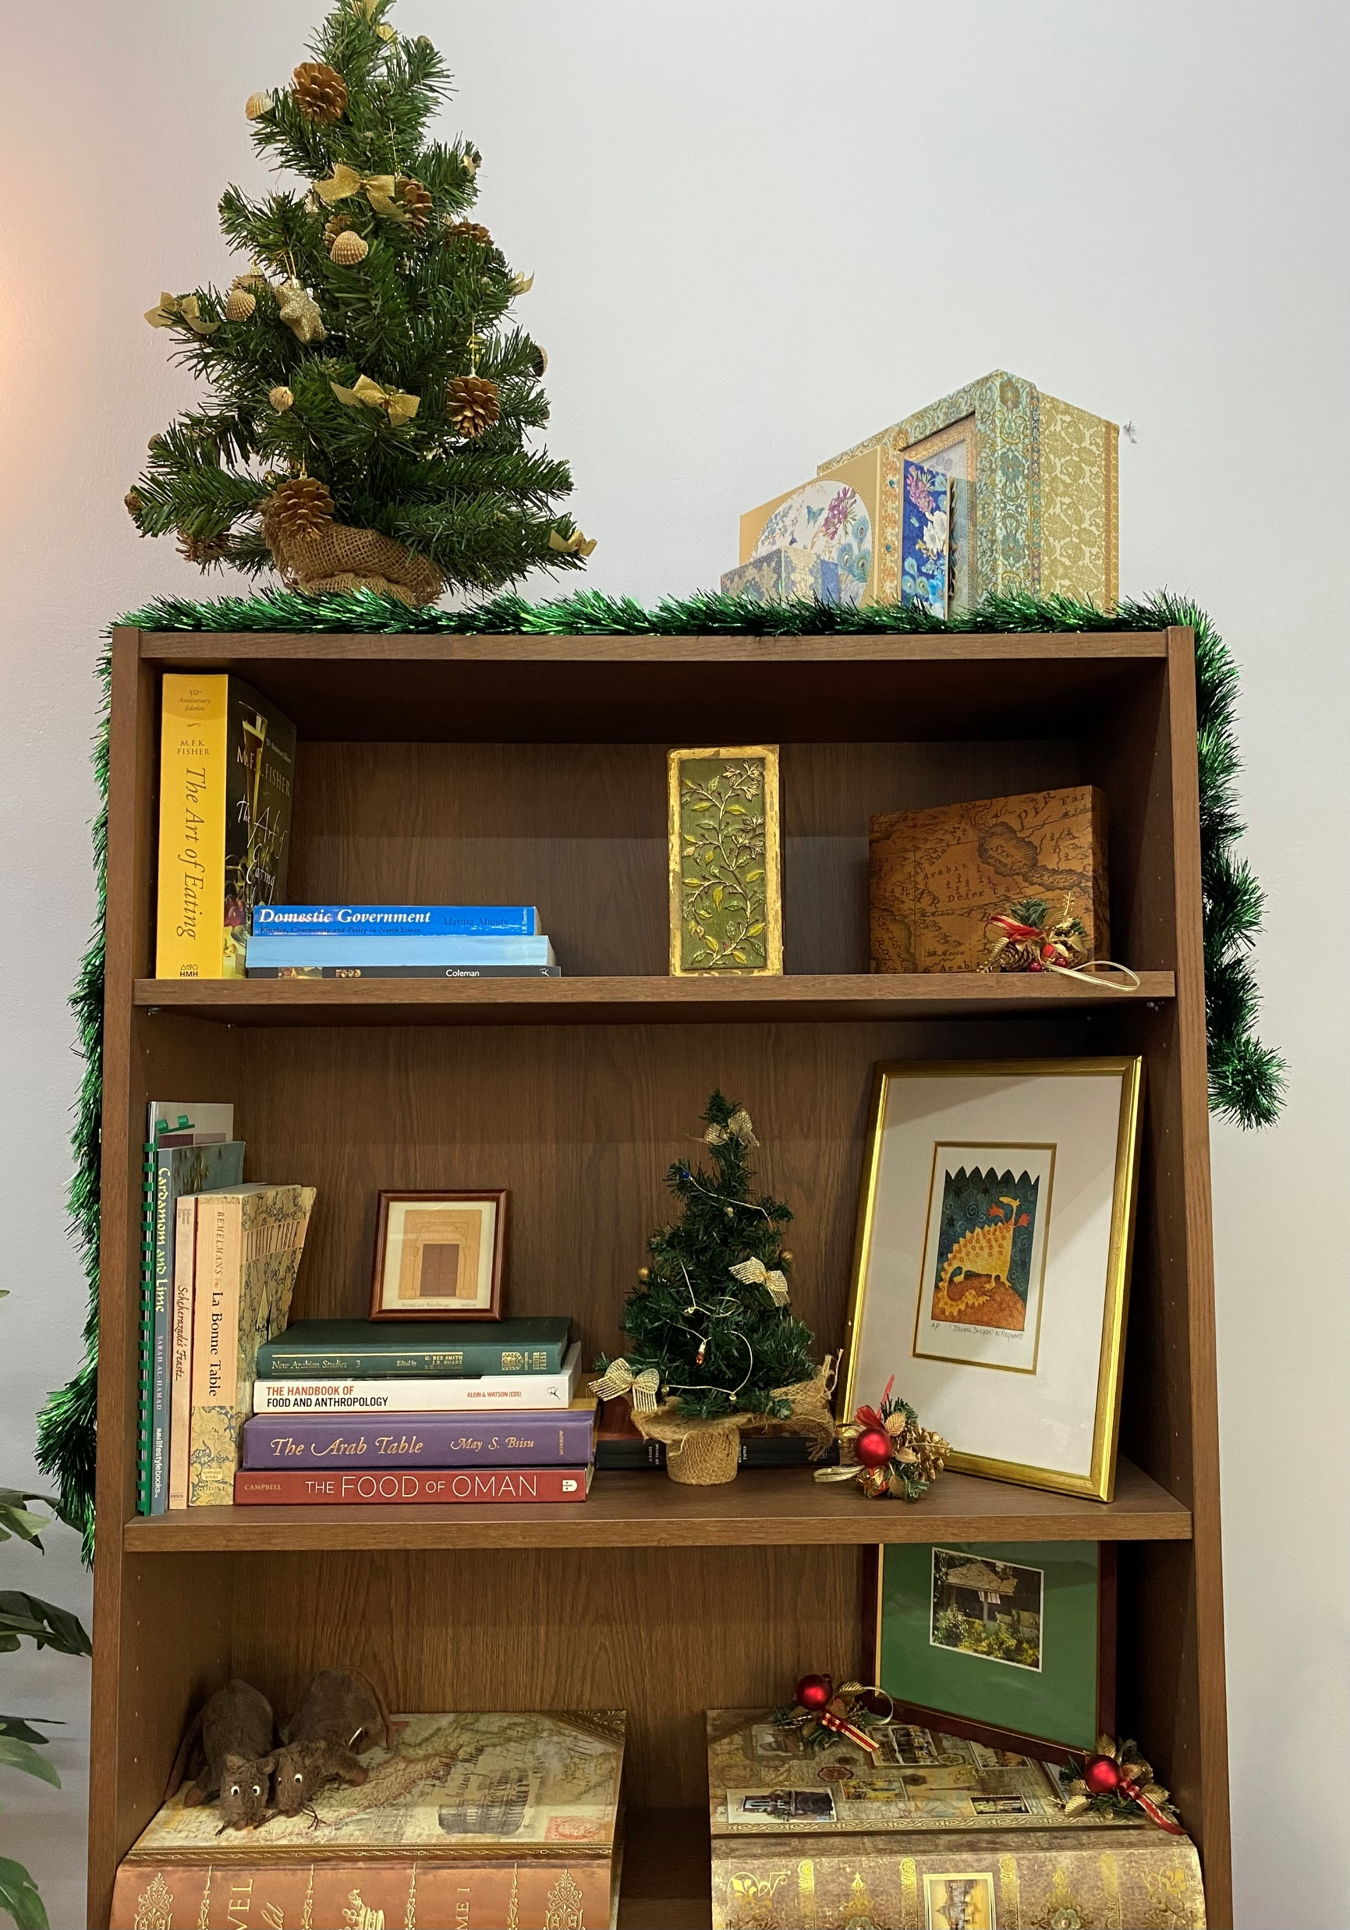
I is for -
Inspirational bookshelves!
(with rats!!)

Slide 24
T is for -
Thankful for friends and family!

Slide 25
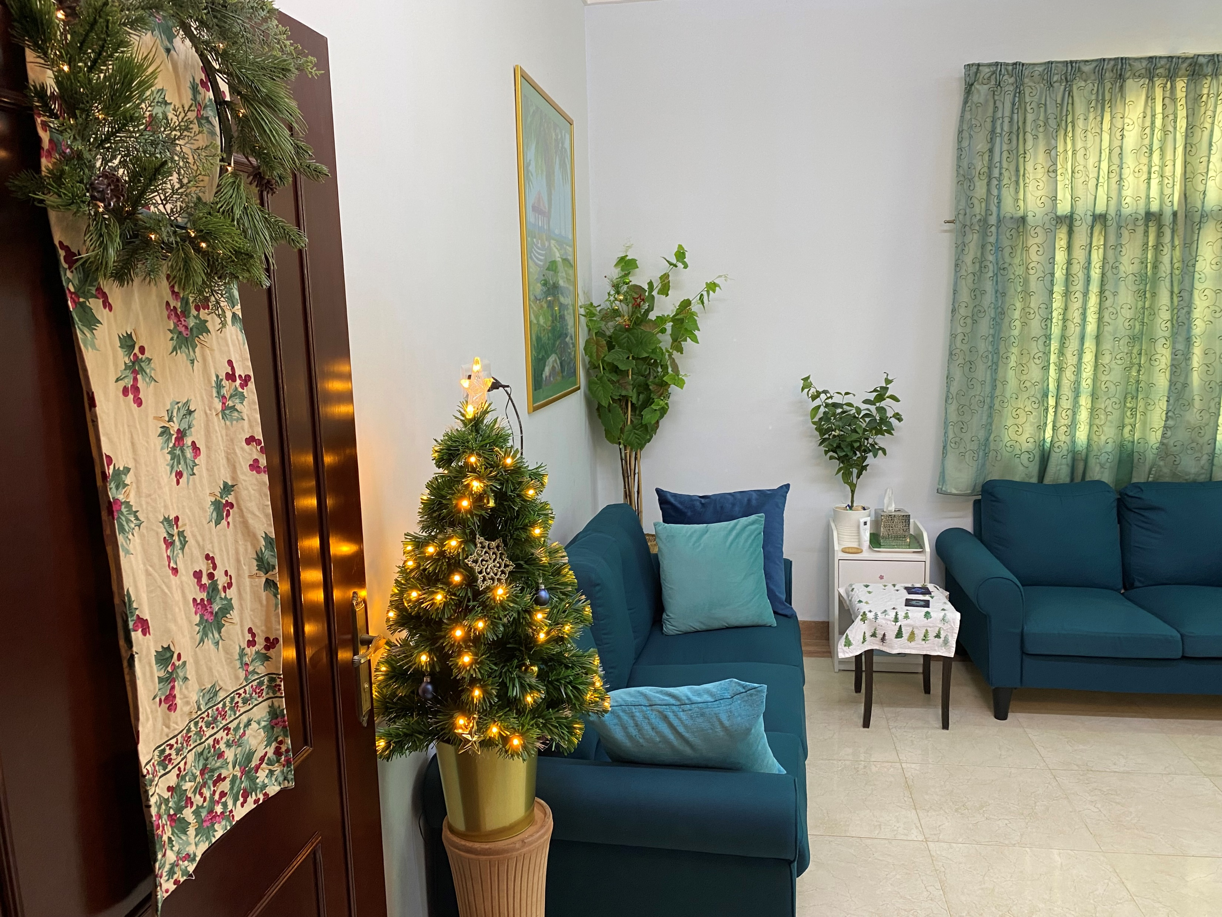
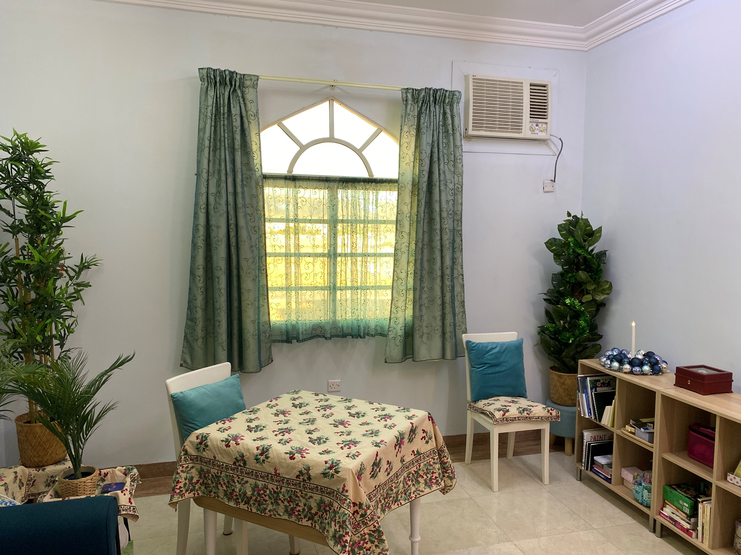
living room

Slide 26
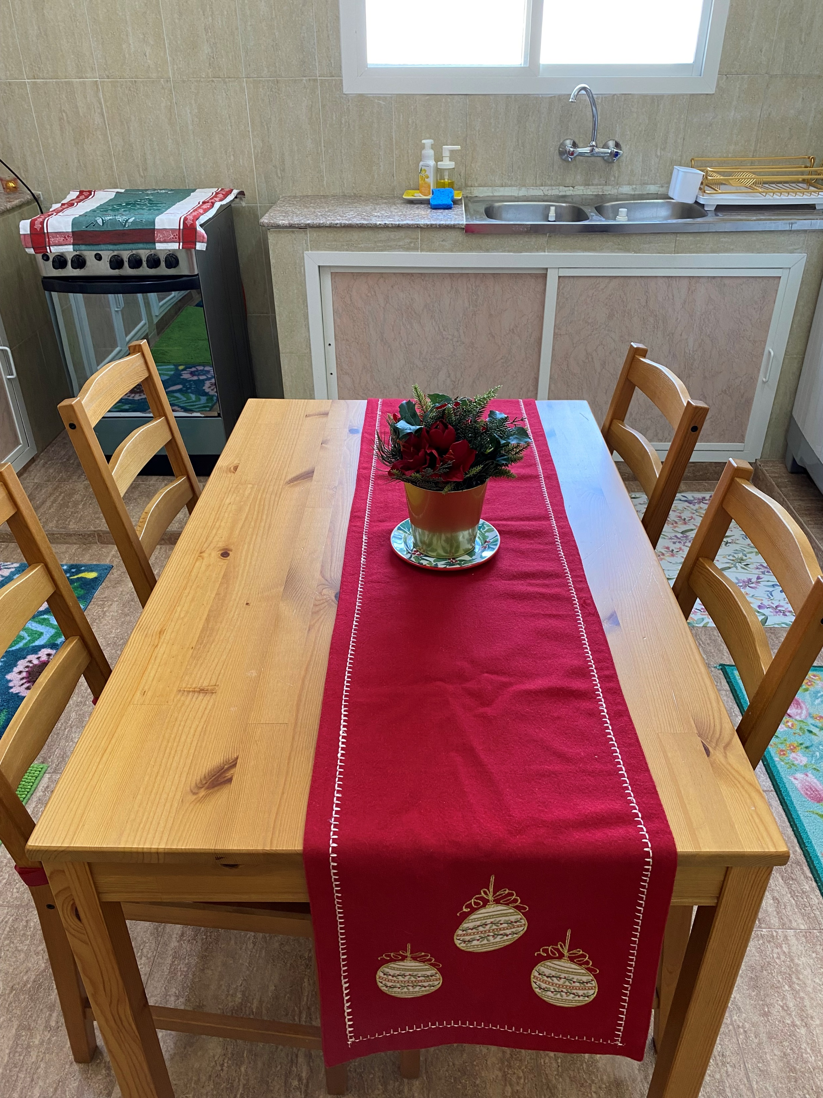
kitchen

Slide 27
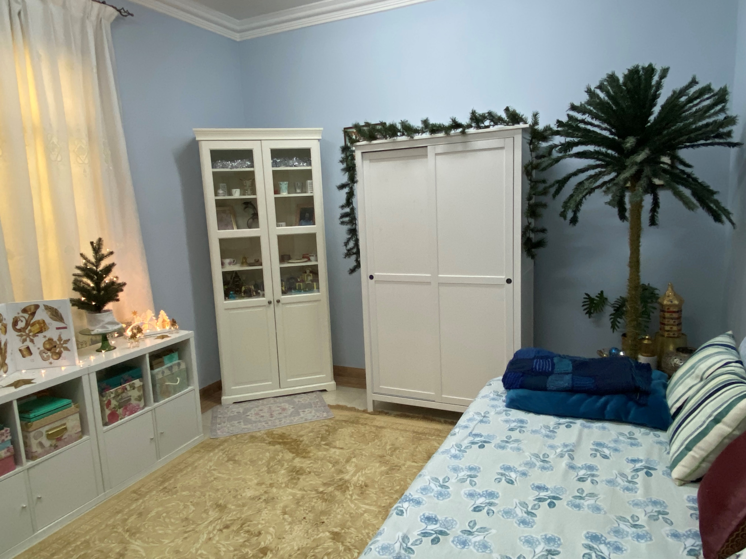
guest room

Slide 28
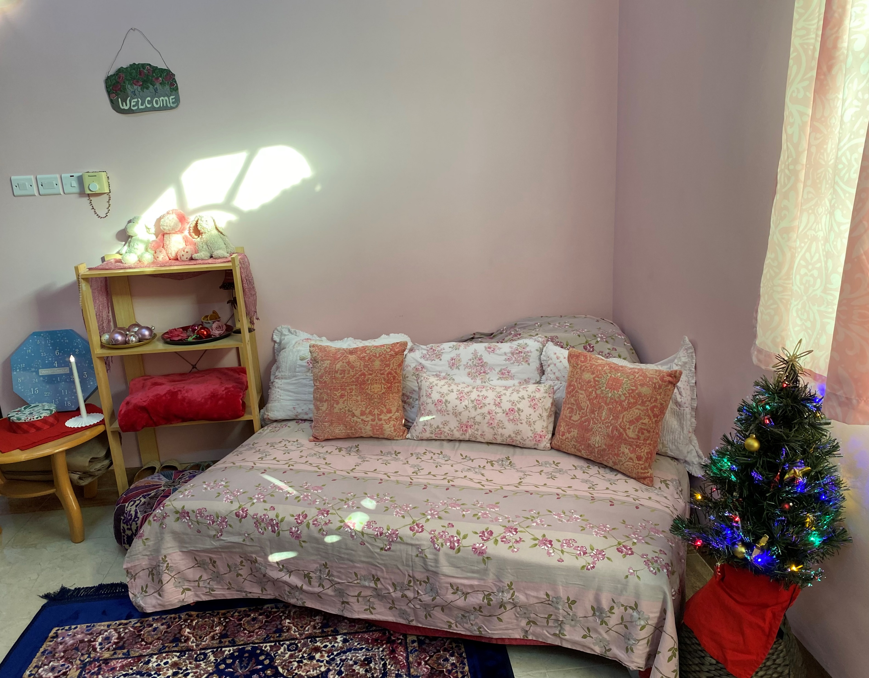
other room

Slide 29
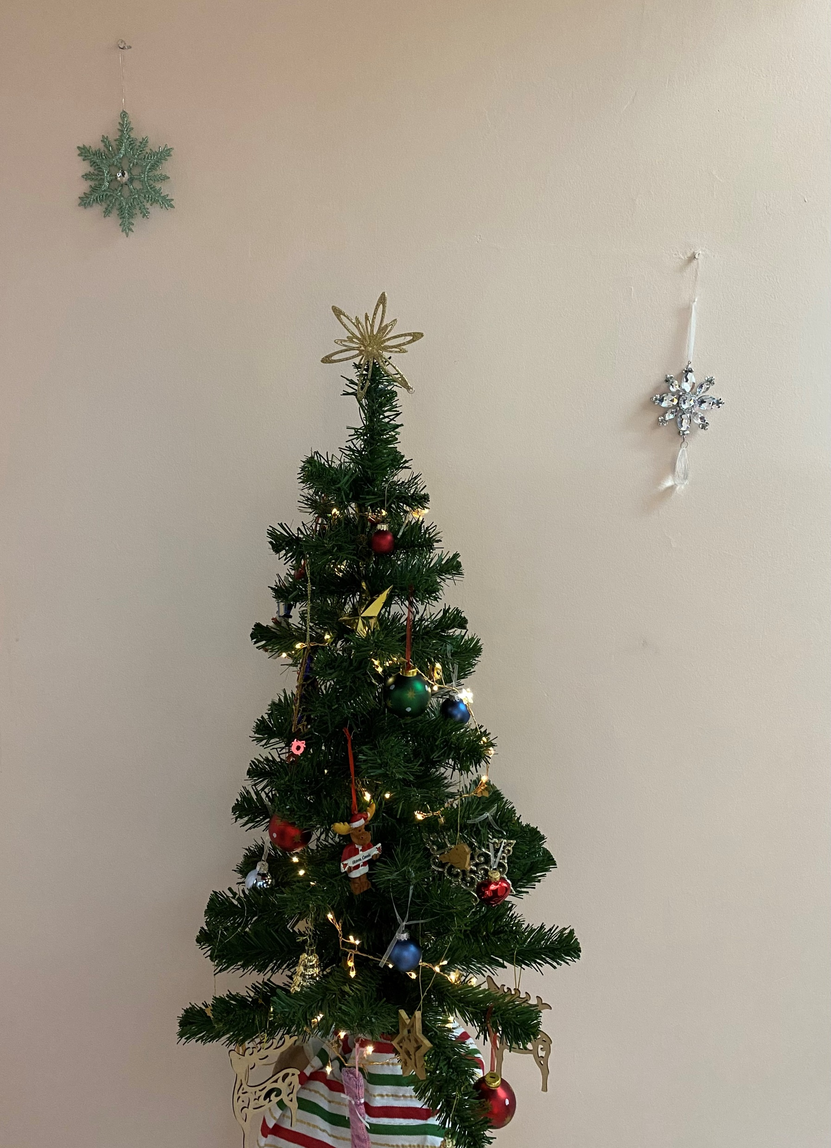
Merry merry to you!

