Slide 1
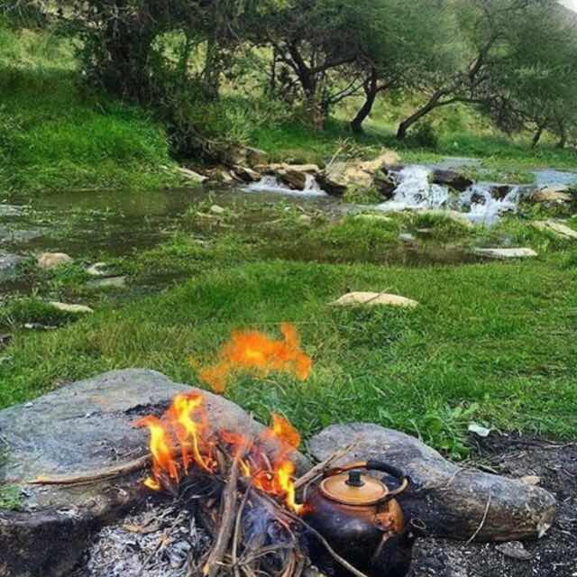
Foodways and Society in Southern Oman
[selected slides]
Dr. Marielle Risse
Dhofar University, Salalah, Oman
BRISMES – June 26, 2019

Slide 2
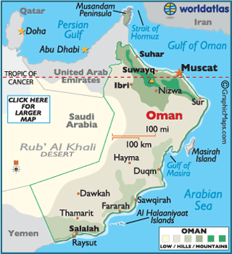
https://www.worldatlas.com/webimage/countrys/asia/om.htm

Slide 3
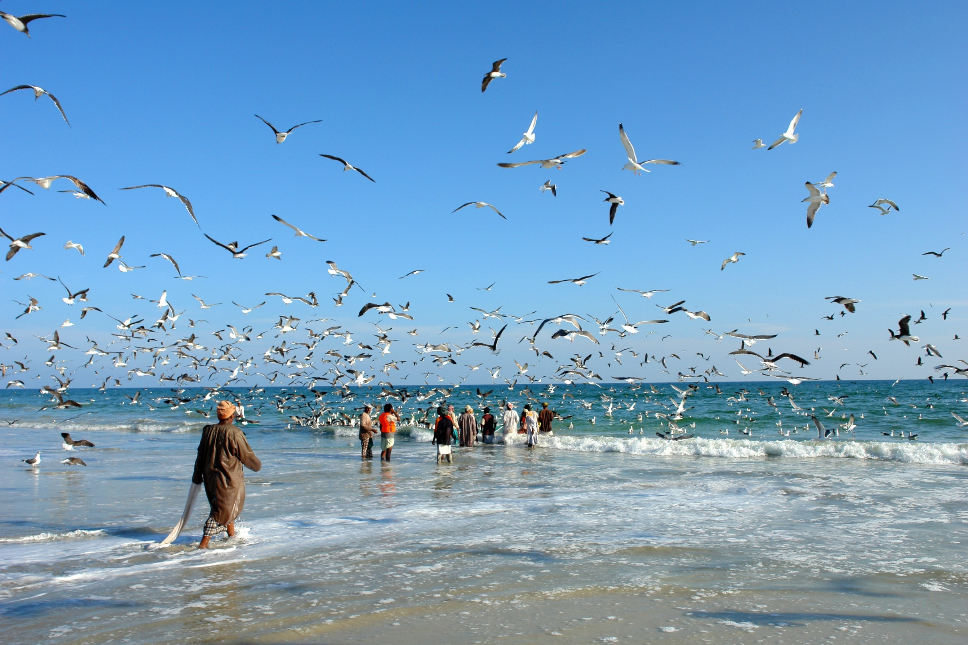

Slide 4
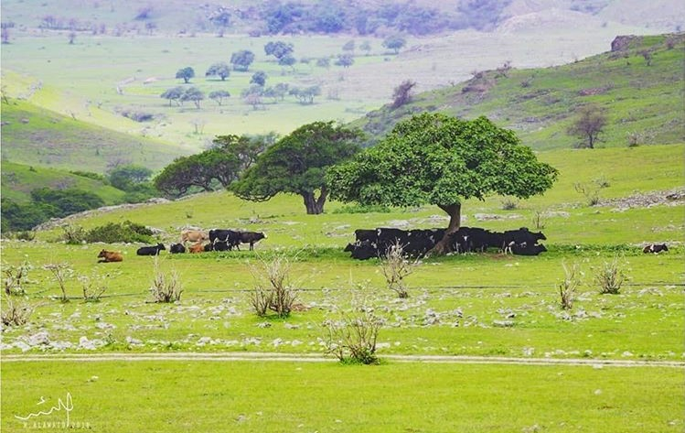

Slide 5
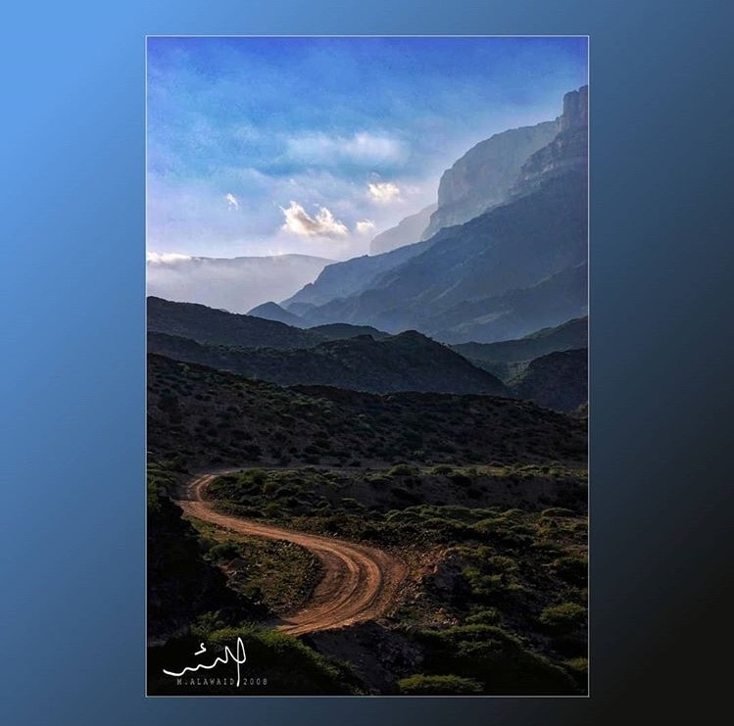

Slide 6


Slide 7
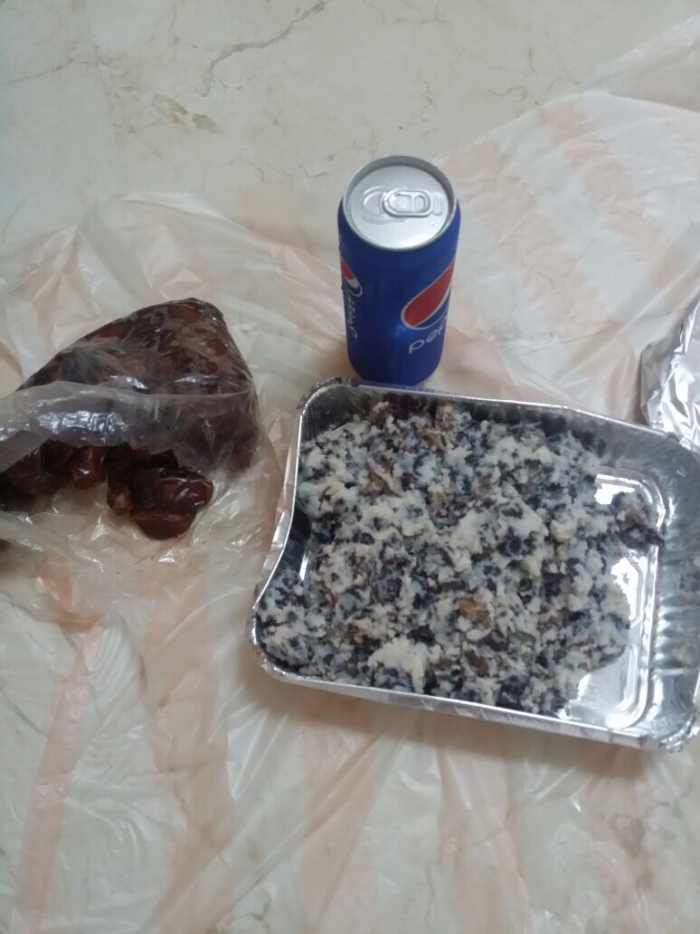
Overview of Foodways
past: barter economy
images of food
acquiring
making
presenting
eating
disposing
sharing

Slide 8
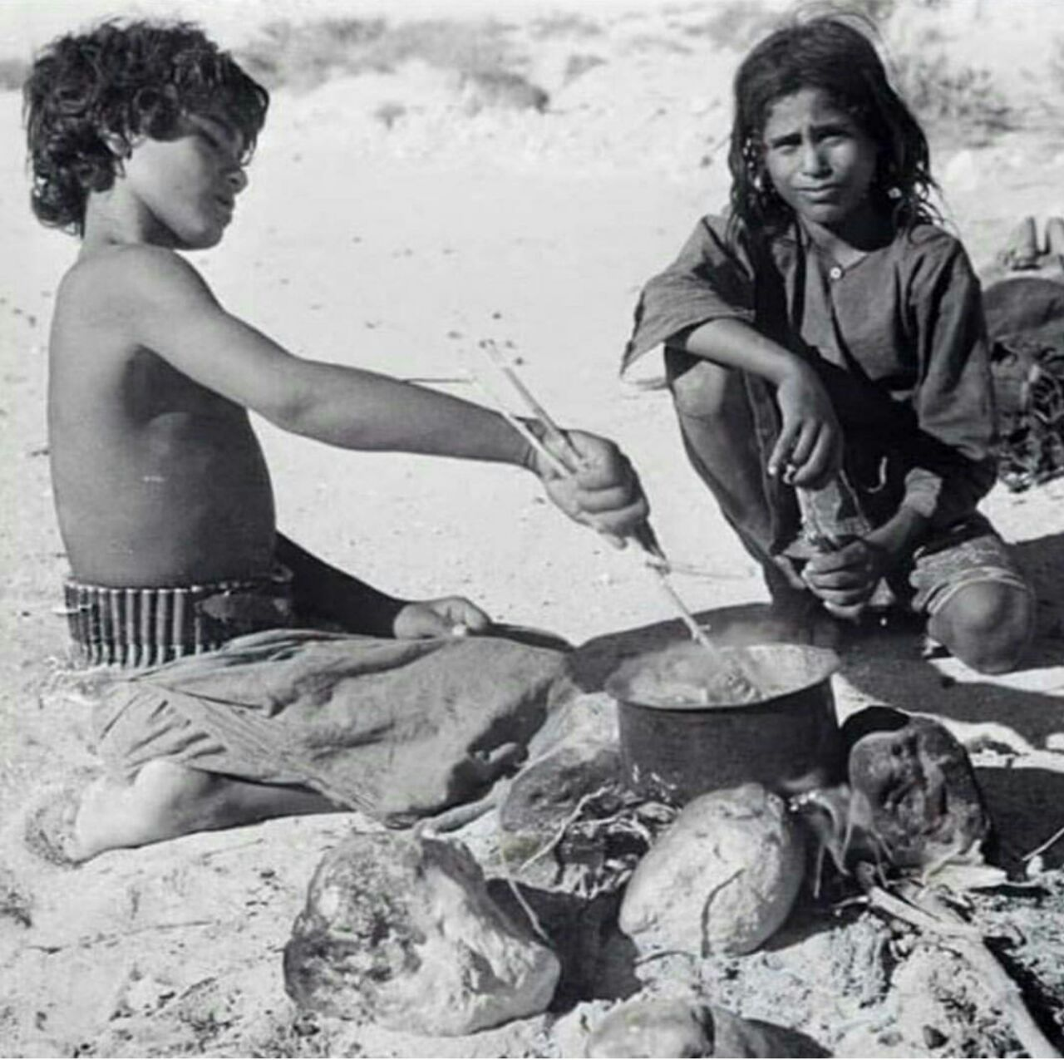
Past
Past - barter economy,
mountain: samn (clarified butter), milk, meat, wood, charcoal, frankincense
coast: fish/ lobster/ abalone as food, sardines as fodder
town: non-locally grown food/ produced items: rice, dates, sugar, fabric, metal objects
http://web.prm.ox.ac.uk/thesiger/images/stories/albums/Thesiger%20Albums%20Volume%2011.pdf

Slide 9



Typical ‘Arabian’ greetings:
dates, coffee/ tea

Slide 10
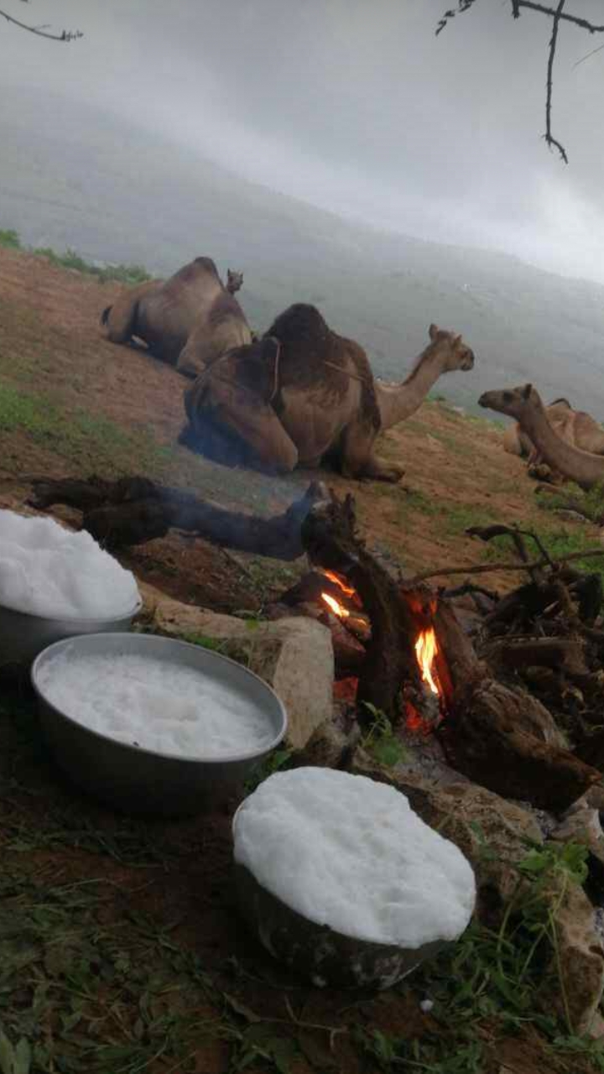
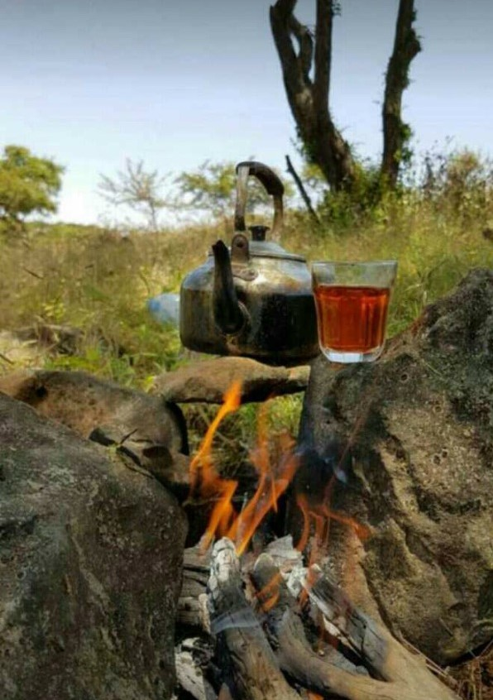
Dhofari-style greetings with food images

Slide 11
Acquiring Food – Receiving and Buying
Ways to get food-stuffs
family and/ or neighbors with animals: milk, samn (clarified butter)
family and/ or neighbors with farms: fruit, vegetables
family and/ or neighbors who fish/ collect mussels
“we have too much” – bulk buying/ receiving
Ways to get prepared food
family and/ or neighbors with celebration (marriage, graduation, etc.)
Eids
Ways to buy food
neighborhood store (credit)
specialist: fruit, bread (credit/ family/ location)
large/ impersonal

Slide 12
Making: When, Where, Who
at home: women alone or w/hired help
  breakfast: 6 - 8am during school weeks, otherwise 9 - 11am)
  lunch: @ 2 pm, main meal, after schools/ gov’t offices closed
  dinner at home: 7 - 11pm
  majlis and salle, tea/ coffee at all times, refreshed often, fruit, covered snacks
away from home: men
  cutting meat
  family or men-only picnics

Slide 13
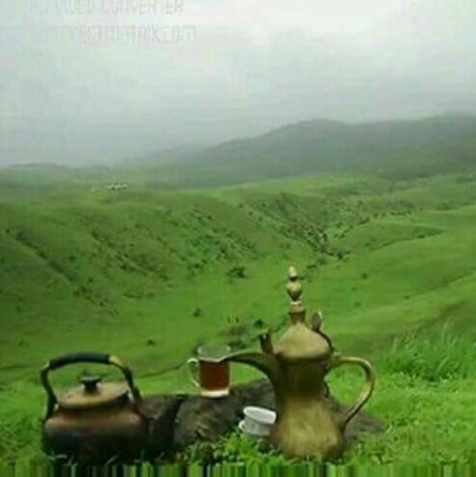
Generosity
  presenting
  sharing/ disposing
  not showing generosity
  masking economic behaviors
  definition of “Good Hosting”
  definition of “Good Guesting”

Slide 14
Presenting
Giving foodstuffs:
raw meat, fish, fruits and vegetables in plastic bags
containers for samn (clarified butter)
used water bottles for milk (camel, cow)
Giving prepared foods (Eid, weddings, daily)
food on covered plastic plates
one-use foil or plastic containers
Changes in HOW food is presented: HomeCentre, CentrePoint
  cupcake papers, cake stands, chafing dishes, ornamental trays, tea pots, paper gift-bags, colored cellophanes and ribbons, personalized stickers with name/ symbol

Slide 15

Generosity and the non-monetary economy
living in small apartment but own the building; old car and building two houses; six children and no job
Clements and Chen (2010) Oman has 22.1 “food share” [percentage of income spent on food for the home] - percentage might be higher if not for the wide-spread and long-term food sharing between relatives and neighbors

Slide 16

Additional Themes
Changes in foodways
Foodways for women and men
Special food categories
  honey
Dhofar and Yemen comparisons
Picnics are best

Slide 17

Dhofari and Yemeni
food traditions
sharing food/ eating together
fighting with food
fighting over guests/ location of honor
Yemeni restaurants

Slide 18
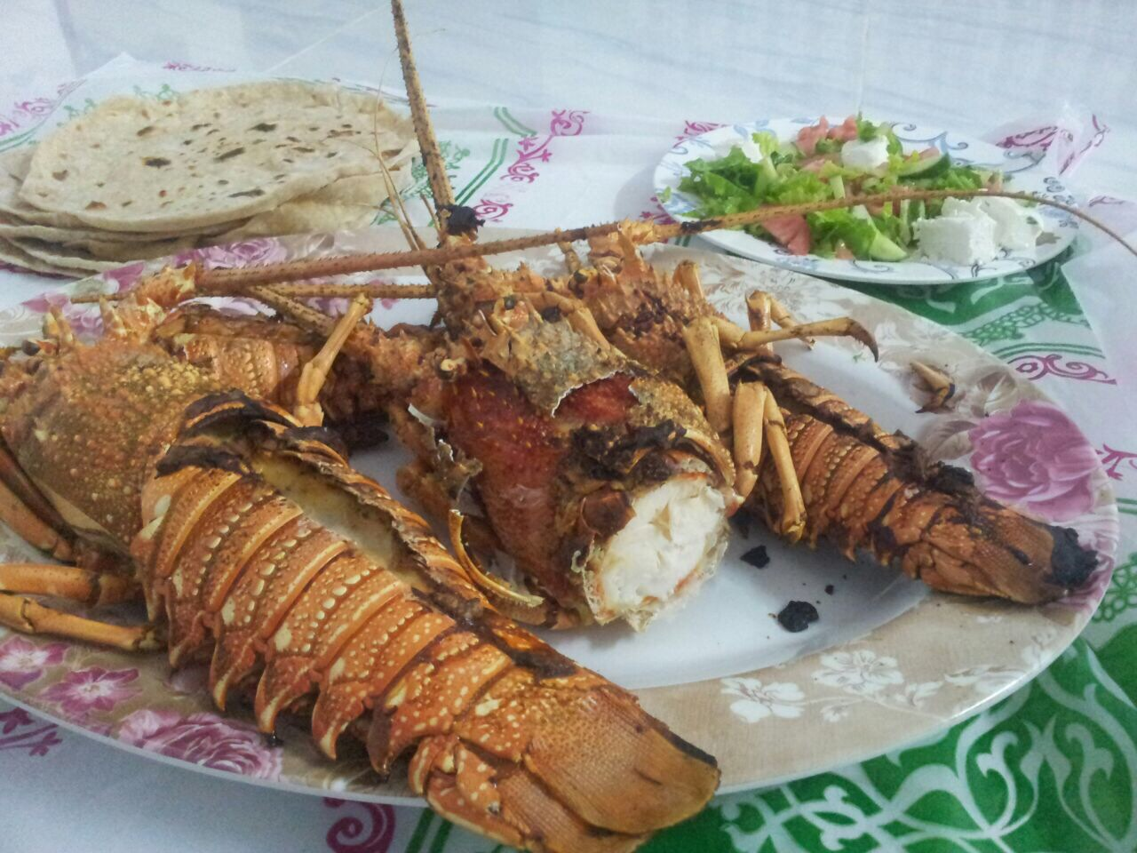
My thanks to my research group photos from social media – landscapes by M. A. Al Awaid https://mariellerisse.com/

